Slide 1
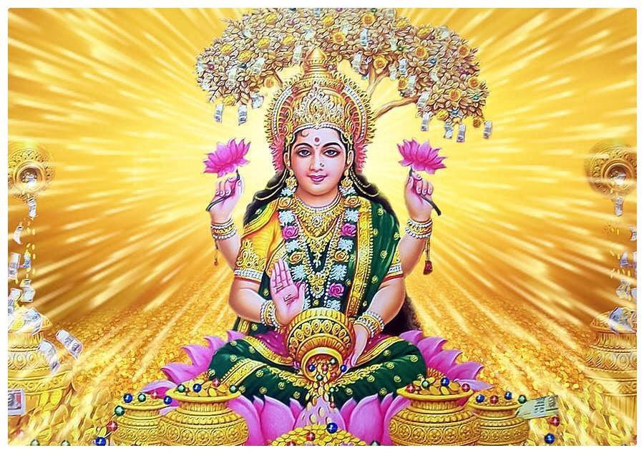

SHRI MAHALAKSHMI ASHTAKAM

Slide 2
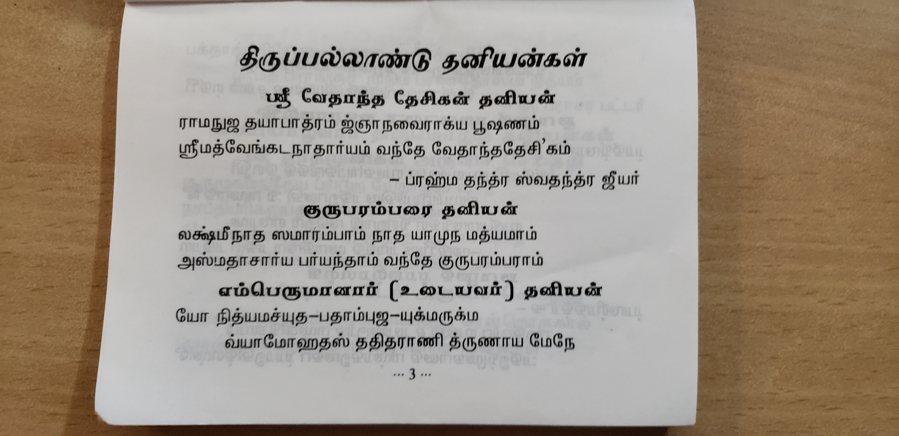
GURU VANDHANAM
Lakshmi naadha samaarambhaam
naadhayaamuna madhyamam
asmathaachaarya paryanthaam
vandhe guru param paraam.
लक्ष्मी नाथ समारंभम नाथयामुन मध्यमाम
असमथाचार्य पर्यन्थं वन्दे गुरु परम्पराम

Slide 3
PASURAM 1
நமஸ்தேஸ்து மஹா மாயே ஸ்ரீபீடே ஸுரபூஜிதே |
சங்க சக்ர கதா ஹஸ்தே மஹாலக்ஷ்மி நமோஸ்துதே ||
namastē'stu mahaaaayē śrīpīṭhē surapūjitē ।
shaṅkha chakra gadaa hastē mahaalakṣmi namō'stu tē
नमस्तेऽस्तु महामाये श्रीपीठे सुरपूजिते ।
शङ्खचक्रगदाहस्ते महालक्ष्मि नमोऽस्तुते ॥१॥

Slide 4
meaning - 1
1.1: Reverential Salutations to You O Mahamaya (the Primordial Cause of Creation); Who Abides in Sri Pitha (Her Transcendental Abode) and is Worshipped by the Suras,
1.2: Who is adorned with Shankha (Conch), Chakra (Discus) and Gada (Mace) in Her Hands; Reverential Salutations to You, O Devi Mahalakshmi.

Slide 5
PASURAM 2
நமஸ்தே கருடாரூடே கோலாஸுர பயங்கரி |
சர்வ பாப ஹரே தேவி மஹாலக்ஷ்மி நமோஸ்துதே || 2 ||
namastē garuḍārūḍhē kōlāsura bhayaṅkari ।
sarva papa harē dēvi mahālakṣmi namō'stu tē ॥ 2
नमस्ते गरुडारूढे कोलासुर भयंकरि ।
सर्वपाप हरे देवि महालक्ष्मि नमोऽस्तुते ॥२॥

Slide 6
meaning - 2
2.1: Reverential Salutations to You Who is mounted on the Garuda, and Who is the Terror to Kolasura,
2.2: (Reverential Salutations to You) O Devi Who Remove All Sins (when we Surrender to Her); Reverential Salutations to You, O Devi Mahalakshmi.

Slide 7
PASURAM 3
சர்வக்ஞே சர்வ வரதே சர்வ துஷ்ட பயங்கரி |
சர்வ துக்க ஹரே தேவி மஹாலக்ஷ்மி நமோஸ்துதே ||
sarvajñē sarvavaradē sarva duṣhṭa bhayaṅkari ।
sarva duḥkha harē dēvi mahālakṣmi namō'stu tē ॥
सर्वज्ञे सर्ववरदे सर्वदुष्टभयंकरि ।
सर्वदुःखहरे देवि महालक्ष्मि नमोऽस्तुते ॥

Slide 8
meaning - 3
3.1: (Reverential Salutations to You) Who is All-Knowing (Knowing even our Innermost Thoughts), and Who Gives All Boons (When Her Grace is Aroused); (Reverential Salutations to You) Who is the Terror to All the Wicked (Tendencies) (Destroying our Evil Tendencies),
3.2: (Reverential Salutations to You) O Devi Who Removes All Sorrows (When Her Compassion is Aroused); Reverential Salutations to You, O Devi Mahalakshmi.

Slide 9
PASURAM 4
சித்தி புத்தி ப்ரதே தேவி
புத்தி முக்தி ப்ரதாயினி |
மந்த்ர மூர்த்தே ஸதாதேவி
மஹாலக்ஷ்மி நமோஸ்துதே ||
siddhi buddhi pradē dēvi bhukti mukti pradāyini ।
mantra mūrtē sadā dēvi mahālakṣmi namō'stu tē ॥
सिद्धि बुद्धि प्रदे देवि भुक्ति मुक्ति प्रदायिनि ।
मन्त्रमूर्ते सदा देवि महालक्ष्मि नमोऽस्तुते ॥४॥

Slide 10
meaning - 4
4.1: (Reverential Salutations to You) O Devi Who Bestows Accomplishments (When She becomes Gracious) and Intelligence (to direct our Lives properly with those Accomplishments); (Reverential Salutations to You) Who Bestows both Worldly Prosperity as well as directs our lives towards final Liberation (Merging in Her Lotus Feet),
4.2: (Reverential Salutations to You) O Devi Who Always Abide as the Subtle Form of Mantra (behind Everything in Creation and Within our Hearts); Reverential Salutations to You, O Devi Mahalakshmi.

Slide 11
PASURAM 5
ஆத்யந்த ரஹிதே தேவி
ஆதிசக்தி மஹேஸ்வரி
யோகஜே யோக ஸம்பூதே
மஹாலக்ஷ்மி நமோஸ்துதே
ādyanta rahitē dēvi ādiśakti mahēśvari ।
yōgajñē yōga sambhūtē mahālakṣmi namō'stu tē ॥
आद्यन्तरहिते देवि आद्यशक्तिमहेश्वरि ।
योगजे योगसम्भूते महालक्ष्मि नमोऽस्तुते ॥५॥

Slide 12
meaning - 5
5.1: (Reverential Salutations to You) O Devi Who is Without Beginning (Aadi) and Without End (Anta), and Who is the Great Goddess representing the Primordial Shakti,
5.2: (Reverential Salutations to You) Who is Born of Yoga (out of the Great Consciousness) and Who is always United with Yoga; Reverential Salutations to You, O Devi Mahalakshmi.

Slide 13
PASURAM 6
ஸ்தூல சூக்ஷ்ம மஹா ரெளத்ரே
மகாசக்தி மஹோதரே |
மஹா பாப ஹரே தேவி
மஹாலக்ஷ்மி நமோஸ்துதே ||
sthūla sūkṣma mahāraudrē
mahāśakti mahōdarē ।
mahā pāpa harē dēvi
mahālakṣmi namō'stu tē ॥
स्थूल सूक्ष्म महारौद्रे महाशक्ति महोदरे ।
महापापहरे देवि महालक्ष्मि नमोऽस्तुते ॥

Slide 14
meaning - 6
6.1: (Reverential Salutations to You) Whose Power is present behind both Gross and Subtle Forms as well as behind the Most Terrible Form of Rudrani; (Reverential Salutations to You) Who is the Great Womb of Mahashakti (from where every manifestation of Power arises),
6.2: (Reverential Salutations to You) O Devi, Who is the Great Remover of Sins, and Who Removes Great Sins from our Lives (when Her Great Power passes through our Lives and Cleanses us) (maybe during adverse circumstances); Reverential Salutations to You, O Devi Mahalakshmi.

Slide 15
PASURAM 7
பத்மாஸன ஸ்திதே தேவி
பரப்ரம்ஹ ஸ்வரூபிணி |
பரமேஸி ஜகந்மாதா:
மஹாலக்ஷ்மி நமோஸ்துதே ||
padmāsana sthitē dēvi parabrahma svarūpiṇi ।
paramēśi jaganmātaḥ mahālakṣmi namō'stu tē ॥
पद्मासनस्थिते देवि परब्रह्मस्वरूपिणि ।
परमेशि जगन्मातर्महालक्ष्मि नमोऽस्तुते ॥७॥

Slide 16
meaning - 7
7.1: (After Her Great Power Cleanses us we feel Her Peaceful Form) O Devi Who is Seated on a Lotus (Lotus of Kundalini) (with a Gracious Face); And Who is abiding as the Supreme Brahman (behind all Creation),
7.2: Who is the Supreme Goddess and the Mother of the Universe; Reverential Salutations to You, O Devi Mahalakshmi.

Slide 17
PASURAM 8
ஸ்வேதாம் பரதரே தேவி
நானாலங்கார பூஷிதே |
ஜகஸ்திதே ஜகந்மாதா:
மஹாலக்ஷ்மி நமோஸ்துதே || 8 ||
śvētāmbaradharē dēvi nānālaṅkāra bhūṣitē ।
jagasthitē jaganmātaḥa mahālakṣmi namō'stu tē ॥
श्वेताम्बरधरे देवि नानालङ्कारभूषिते ।
जगत्स्थिते जगन्मात: र्महालक्ष्मि नमोऽस्तुते ॥८॥

Slide 18
meaning - 8
8.1: (Reverential Salutations to You) O Devi Who is Adorned with White Garments (representing our Inner Purity); (Reverential Salutations to You) Who is Adorned with Various Ornaments (representing our Inner Beauty),
8.2: (Reverential Salutations to You) Who Abide within the Universe as the Mother of the Universe (directing our Lives and all Activities); Reverential Salutations to You, O Devi Mahalakshmi.

Slide 19
Phalashruthi
மஹாலக்ஷ்மி அஷ்டக ஸ்தோத்ரம்
ய: படேத் பக்திமாந் நர: |
ஸர்வ ஸித்தி மவாப்நோதி
ராஜ்யம் ப்ராப்நோதி ஸர்வதா: |
mahālakṣmaṣṭakaṃ stōtraṃ
yaḥ paṭhēd bhaktimān naraḥ ।
sarva siddhi mavāpnōti
rājyaṃ prāpnōti sarvadā ॥
महालक्ष्म्यष्टकं स्तोत्रं यः पठेद्भक्तिमान्नरः ।
सर्वसिद्धिमवाप्नोति राज्यं प्राप्नोति सर्वदा ॥९॥

Slide 20
phalashruti - 1
9.1: He who recites this Mahalakshmi Ashtakam Stotram with Devotion (surrendering to Her), ...
9.2: ... Will attain all Accomplishments (including final Liberation) and Prosperity (both Inner and Outer), always (when She Herself directs our Lives).

Slide 21

Phalashruthi
ஏக காலம் படேந் நித்யம்
மஹாபாப விநாஸனம் |
த்வி காலம் ய: படேந் நித்யம்
தன தான்ய ஸமன்வித: ||
Eka-Kaale Patthen-Nityam
Mahaa-Paapa-Vinaashanam |
Dvi-Kaalam Yah Patthen-Nityam
Dhana-Dhaanya-Samanvitah ||
एककाले पठेन्नित्यं महापापविनाशनम् ।
द्विकालं यः पठेन्नित्यं धनधान्यसमन्वितः ॥१०॥

Slide 22
phalashruti - 2
10.1: Reciting this Once Every Day (representing the first outcome) will Destroy Great Sins (first our gross Sins need to get destroyed by Her Power for the Purity to emerge),
10.2: Reciting this Twice Every Day (representing the second outcome) will bestow Wealth and Foodgrains (by our effort in the path of Dharma).

Slide 23
Phalashruthi
திரி காலம் ய: படேந் நித்யம்
மஹா சத்ரு விநாஸனம் |
மஹாலக்ஷ்மிர் பவேந் நித்யம்
ப்ரஸன்ன வரதா ஸுபா. ||
Tri-Kaalam Yah Patthen-Nityam
Mahaa-Shatru-Vinaashanam |
Mahaalakssmir-Bhaven-Nityam
Prasannaa Varadaa Shubhaa ||
त्रिकालं यः पठेन्नित्यं महाशत्रुविनाशनम् ।
महालक्ष्मिर्भवेन्नित्यं प्रसन्ना वरदा शुभा ॥११॥

Slide 24
phalashruti - 3
11.1: Reciting this Thrice Everyday (representing the third outcome) will Destroy Great Enemies (including our powerful subtle Inner Enemies which form the final hindrance from progressing towards Liberation),
11.2: (Finally nearing Liberation with a Pure Mind we find) Devi Mahalakshmi in Her Eternal Gracious Form; In Her Eternal Boon-Giving Grace and Auspicious Presence (within us).

Slide 25
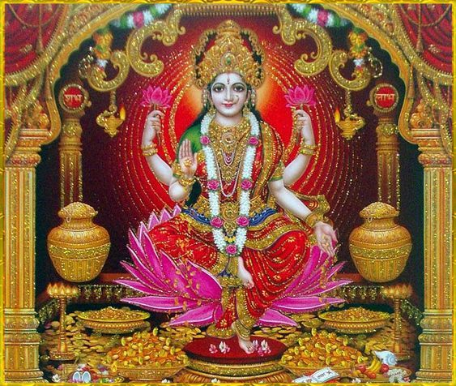

Slide 26
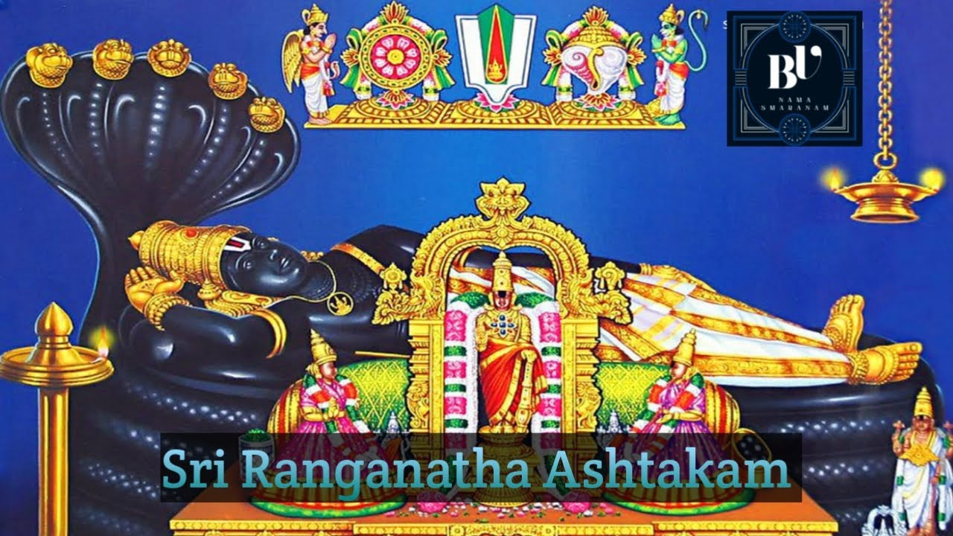


Slide 27
PASURAM 1
ஆநந்த³ரூபே நிஜபோ³த⁴ரூபே ப்³ரஹ்மஸ்வரூபே ஶ்ருதிமூர்திரூபே ।
ஶஶாங்கரூபே ரமணீயரூபே ஶ்ரீரங்க³ரூபே ரமதாம் மநோ மே ॥1॥
Aananda Ruupe Nija Bodha Ruupe Brahma Svaruupe Shruti Muurti Ruupe |
Shashaangka Ruupe Ramanniiya Ruupe Shriirangga Ruupe Ramataam Mano Me || 1 ||
आनन्दरूपे निजबोधरूपे ब्रह्मस्वरूपे श्रुतिमूर्तिरूपे ।
शशाङ्करूपे रमणीयरूपे श्रीरङ्गरूपे रमतां मनो मे ॥१॥
Meaning: 1.1 (My Mind delights in the Divine Form of Sri Ranganatha) That Form (resting on the Adisesha) absorbed in Bliss (Ananda Rupe), and immersed in His Own Self (Nija Bodha Rupe); That Form embodying the essence of Brahman (Brahma Svarupe) and the essence of all the Shrutis (Vedas) (Shruti Murti Rupe),That Form Cool like the Moon (Shashanka Rupe) and having Exquisite Beauty (Ramaniya Rupe);

Slide 28
PASURAM 2
காவேரிதீரே கருணாவிலோலே மந்தா³ரமூலே த்⁴ருʼதசாருகேலே ।
தை³த்யாந்தகாலே ঽகி²லலோகலீலே ஶ்ரீரங்க³லீலே ரமதாம் மநோ மே ॥2॥
Kaaveri Tiire Karunnaa Vilole Mandaara Muule Dhrta Caaru Kele |
Daityaanta Kaale [A]khila Loka Liile Shriirangga Liile Ramataam Mano Me || 2 ||
कावेरितीरे करुणाविलोले मन्दारमूले धृतचारुकेले ।
दैत्यान्तकालेऽखिललोकलीले श्रीरङ्गलीले रमतां मनो मे ॥२॥
Meaning: 2.1 (My Mind delights in the Divine Plays of Sri Ranganatha) Those Plays of Him, showering Compassion at the bank of river Kaveri (just like its gentle waves); Those Plays of Him assuming Beautiful Sportive Forms at the root of the Mandara Tree,2.2: Those Plays of His Incarnations slaying the Demons in all the Lokas (Worlds);
My Mind delights in the Divine Plays of Sri Ranga (Sri Ranganatha) (Those Plays fill my being with Bliss).

Slide 29
PASURAM 3
லக்ஷ்மீநிவாஸே ஜக³தாம் நிவாஸே ஹ்ருʼத்பத்³மவாஸே ரவிபி³ம்ப³வாஸே ।
க்ருʼபாநிவாஸே கு³ணப்³ருʼந்த³வாஸே ஶ்ரீரங்க³வாஸே ரமதாம் மநோ மே ॥
Lakssmii Nivaase Jagataam Nivaase Hrt Padma Vaase Ravi Bimba Vaase |
Krpaa Nivaase Gunna Brnda Vaase Shriirangga Vaase Ramataam Mano Me ||
लक्ष्मीनिवासे जगतां निवासे हृत्पद्मवासे रविबिम्बवासे ।
कृपानिवासे गुणबृन्दवासे श्रीरङ्गवासे रमतां मनो मे ॥३॥
Meaning: 3.1 (My Mind delights in the various Abodes of Sri Ranganatha) That Abode of Him dwelling with Devi Lakshmi (in Vaikuntha), Those Abodes of Him dwelling amidst all the beings in this World (in Temples), That Abode of Him within the Lotus of the Hearts of the Devotees (as Divine Consciousness), and That Abode of Him within the Orb of the Sun (the Sun representing the Image of the Divine), 3.2: That Abode of Him in the acts of Compassion, and That Abode of Him within the Excellent Virtues;

Slide 30
PASURAM 4
ப்³ரஹ்மாதி³வந்த்³யே ஜக³தே³கவந்த்³யே முகுந்த³வந்த்³யே ஸுரநாத²வந்த்³யே ।
வ்யாஸாதி³வந்த்³யே ஸநகாதி³வந்த்³யே ஶ்ரீரங்க³வந்த்³யே ரமதாம் மநோ மே ॥
Brahmaadi Vandye Jagad Eka Vandye Mukunda Vandye Sura Naatha Vandye |
Vyaasaadi Vandye Sanakaadi Vandye Shriirangga Vandye Ramataam Mano Me ||
ब्रह्मादिवन्द्ये जगदेकवन्द्ये मुकुन्दवन्द्ये सुरनाथवन्द्ये ।
व्यासादिवन्द्ये सनकादिवन्द्ये श्रीरङ्गवन्द्ये रमतां मनो मे ॥४॥
Meaning: 4.1: (My Mind delights in the Worship of Sri Ranganatha) The Worship performed by Lord Brahma and other (Gods); The Worship performed by the Devotees (considering Him) as the One Lord of the Universe; The Worship performed by Sri Mukunda, and the Worship performed by the Chief of the Suras (i.e. Indra Deva),
4.2: The Worship performed by Sage Vyasa and other (Sages); The Worship performed by Sage Sanaka and other (Kumaras); My Mind delights in the Worship of Sri Ranga (Sri Ranganatha) (His Worship fills my being with Bliss).

Slide 31
PASURAM 5
ப்³ரஹ்மாதி⁴ராஜே க³ருடா³தி⁴ராஜே வைகுண்ட²ராஜே ஸுரராஜராஜே ।
த்ரைலோக்யராஜேঽ கி²லலோகராஜே ஶ்ரீரங்க³ராஜே ரமதாம் மநோ மே ॥
Brahmaa [A]dhiraaje Garudda Adhiraaje Vaikunnttha Raaje Sura Raaja Raaje |
Trailokya Raaje [A]khila Loka Raaje Shriirangga Raaje Ramataam Mano Me ||
ब्रह्माधिराजे गरुडाधिराजे वैकुण्ठराजे सुरराजराजे ।
त्रैलोक्यराजेऽखिललोकराजे श्रीरङ्गराजे रमतां मनो मे ॥५॥
Meaning: 5.1: (My Mind delights in the Lordship of Sri Ranganatha) Who is the Lord of Brahma, Who is the Lord of Garuda, Who is the Lord of Vaikuntha and Who is the Lord of the King of Suras (i.e. Indra Deva),
5.2: Who is the Lord of the Three Worlds, Who is the Lord of All the Worlds;
My Mind delights in the Lordship of Sri Ranga (Sri Ranganatha) (His Lordship fills my being with Bliss).

Slide 32
PASURAM 6
அமோக⁴முத்³ரே பரிபூர்ணநித்³ரே ஶ்ரீயோக³நித்³ரே ஸஸமுத்³ரநித்³ரே ।
ஶ்ரிதைகப⁴த்³ரே ஜக³தே³கநித்³ரே ஶ்ரீரங்க³ப⁴த்³ரே ரமதாம் மநோ மே ॥6॥
Amogha Mudre Paripuurnna Nidre Shrii Yoga Nidre Sa Samudra Nidre |
Shritai[a E]ka Bhadre Jagad Eka Nidre Shriirangga Bhadre Ramataam Mano Me ||
अमोघमुद्रे परिपूर्णनिद्रे श्रीयोगनिद्रे ससमुद्रनिद्रे ।
श्रितैकभद्रे जगदेकनिद्रे श्रीरङ्गभद्रे रमतां मनो मे ॥६॥
Meaning: 6.1: (My Mind delights in the Auspicious Divine Sleep of Sri Ranganatha) That Posture of Unfailing Rest (which nothing can disturb), That Complete Sleep (which is full with Fullness), That Auspicious Yoga Nidra (which is absorbed in Itself in Fullness), (and) That Posture of Sleeping over the Milky Ocean (and controlling everything),
6.2: That Posture of Rest is the One Source of Auspiciousness (in the Universe) and One great Sleep which (gives Rest amidst all the Activities and) finally absorbs the Universe.

Slide 33
PASURAM 7
ஸ சித்ரஶாயீ பு⁴ஜகே³ந்த்³ரஶாயீ நந்தா³ங்கஶாயீ கமலாங்கஶாயீ ।
க்ஷீராப்³தி⁴ஶாயீ வடபத்ரஶாயீ ஶ்ரீரங்க³ஶாயீ ரமதாம் மநோ மே ॥
Sacitra Shaayii Bhujage[a I]ndra Shaayii Nanda Angka Shaayii Kamalaa [A]ngka Shaayii |
Kssiira Abdhi Shaayii Vatta Patra Shaayii Shriirangga Shaayii Ramataam Mano Me ||
सचित्रशायी भुजगेन्द्रशायी नन्दाङ्कशायी कमलाङ्कशायी ।
क्षीराब्धिशायी वटपत्रशायी श्रीरङ्गशायी रमतां मनो मे ॥७॥
Meaning: 7.1: (My Mind delights in the Auspicious Resting Poses of Sri Ranganatha) That Resting Pose adorned with variegated (Garments and Ornaments); That Resting Pose over the King of Serpents (i.e. Adisesha); That Resting Pose on the Lap of Nanda Gopa (and Yashoda); That Resting Pose on the Lap of Devi Lakshmi, 7.2: That Resting Pose over the Milky Ocean; (And) That Resting Pose over the Banyan Leaf; My Mind delights in the Auspicious Resting Poses of Sri Ranga (Sri Ranganatha) (Those Auspicious Resting Poses fill my being with Bliss).

Slide 34
PASURAM 8
இத³ம் ஹி ரங்க³ம் த்யஜதாமிஹாங்க³ம் புநர்நசாங்கம் யதி³ சாங்க³மேதி ।
பாணௌ ரதா²ங்க³ம் சரணேம்பு³ கா³ங்க³ம் யாநே விஹங்க³ம் ஶயநே பு⁴ஜங்க³ம் ॥
Idam Hi Ranggam Tyajataam Ihanggam Punar Na Chaangam Yadi Chaangameti |
Paannau Rathaangam CharaNembu Gaangam Yaane Vihangam Shayane Bhujangam ||
इदं हि रङ्गं त्यजतामिहाङ्गं पुनर्न चाङ्गं यदि चाङ्गमेति ।
पाणौ रथाङ्गं चरणेऽम्बु गाङ्गं याने विहङ्गं शयने भुजङ्गम् ॥८॥
Meaning: 8.1: This indeed is Ranga (Srirangam), where if anyone sheds his Body, will not come back again with Body (i.e. will not be born again), if that Body had approached the Lord (i.e. taken refuge in the Lord),
8.2: (Glory to Sri Ranganatha) Whose Hand holds the Discus, From Whose Lotus Feet River Ganga originates, Who rides on His Bird Vehicle (Garuda); (And) Who Sleeps on the Bed of Serpent (Glory to Sri Ranganatha).

Slide 35
PHALASHRUTI
ரங்க³நாதா²ஷ்டகம் புண்யம் ப்ராதருத்தா²ய ய: படே²த் ।
ஸர்வாந் காமாநவாப்நோதி ரங்கி³ஸாயுஜ்யமாப்நுயாத் ॥
Rangganaatha Assttakam Punnyam Praatar Utthaaya Yah Patthet |
Sarvaan Kaamaan Avaapnoti Ranggi Saayujyam Aapnuyaat
रङ्गनाथाष्टकम्पुण्यं प्रातरुत्थाय यः पठेत् ।
सर्वान् कामानवाप्नोति रङ्गिसायुज्यमाप्नुयात् ॥९॥
Meaning: 9.1: This Ranganathashtakam, which is Auspicious, He who recites after getting up early in the Morning,
9.2: All his desires are fulfilled; (And finally) he attains the Sayujya of Sri Ranganatha (Absorption in the essence of Sri Ranganatha) (and gets liberated).

Slide 36
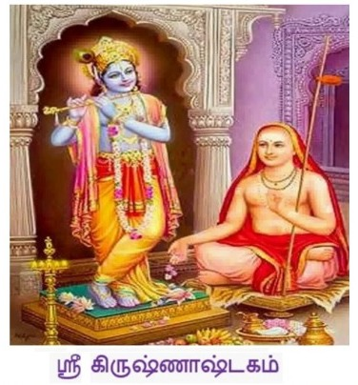

Slide 37
Vasudeva Sutam Devam
Kamsa Chaanura Mardanam।
Devaki Paramaaanandam
Krishnam Vande Jagadgurum॥1॥
வஸுதேவ ஸுதம் தேவம்
கம்ஸ சாணூர மர்தனம் ।
தேவகீ பரமானந்த3ம்
கிருஷ்ணம் வன்தே ஜகத் குரும் ॥

Slide 38
Salutations to the teacher of the world, Krishna,
Who is the God who is the son of Vasudeva,
Who killed Kamsa and Chanoora,
And who gave immense joy to Devaki.

Slide 39
Atasi Pushpa Sankaasham
Haara Noopura Shobhitam।
Ratna Kankana Kehyuram
Krishnam Vande Jagadgurum॥2॥
அதஸீ புஷ்ப ஸங்காஶம்
ஹார நூபுர ஶோபிதம் ।
ரத்ன கங்கண கேயூரம்
கிருஷ்ணம் வன்தே ஜகத்குரும் ॥

Slide 40
Salutations to the teacher of the world, Krishna,
Who decorates himself with flowers of Athasee.
Who shines in garlands and anklets that he wears.
And who has a bangle made of jewels in his right hand..

Slide 41
Kutilaalaka Sammyuktam
Purna chandra Nibhaananam।
Vilasat Kundala dharam devam
Krishnam Vande Jagadgurum॥3॥
குடிலாலக ஸம்யுக்தம்
பூர்ணசன்த்ர நிபா4னநம் ।
விலஸத் குண்டலதரம் தேவம்
கிருஷ்ணம் வன்தே ஜகத் குரம் ॥

Slide 42
Salutations to the teacher of the world, Krishna,
Who is blessed with black curly hair,
Who is very similar to the full moon,
And who shines in his ear drops.

Slide 43
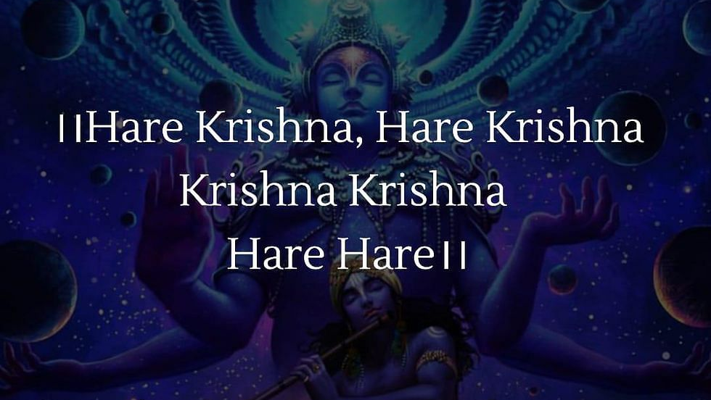

Slide 44
Mandaara Gandha Sammyuktam
Chaaruhaasam Chaturbhujam।
Barhi Pinchhaava Choodaangam
Krishnam Vande Jagadgurum॥4॥
மம்தார கம்த ஸம்யுக்தம்
சாருஹாஸம் சதுர்புஜம் |
பர்ஹி பிம்சாவ சூடாங்கம்
கிருஷ்ணம் வன்தே ஜகத்குரும் || 4 ||

Slide 45
Salutations to the teacher of the world, Krishna.
Who has the sweet scent of mandara flowers,
Who has a pretty smile and four arms,
And who decorates is hair with peacock feathers

Slide 46
Utphulla Padma patraaksham
Neela Jeemuta Sannibham।
Yadavaanam Shiroh ratnam
Krishnam Vande Jagad gurum॥5॥
உத்புல்ல பத்ம பத்ராக்ஷம்
நீல ஜீமூத ஸன்னிபம் |
யாதவானாம் ஶிரோரத்னம
கிருஷ்ணம் வந்தே ஜகத்குரும் || 5 ||

Slide 47
Salutations to the teacher of the world, Krishna,
Who has eyes resembling the fully open lotus flowers,
Who has the blue colour of rich clouds,
And who is the chief gem of the clan of Yadavas.

Slide 48
Rukmiiini Keli Sammyuktam
Pitaambara Sushobhitam।
Avaapta Tulasi Gandham
Krishnam Vande Jagad gurum॥6॥
ருக்மிணீ கேளி ஸம்யுக்தம்
பீதாம்பர ஸுஶோபிதம் ।
அவாப்த துலஸீ கந்தம்
கிருஷ்ணம் வந்தே ஜகத்குரும் ॥6॥

Slide 49
Salutations to the teacher of the world, Krishna,
Who is engaged in playing with Rukmani,
Who shines in yellow silks,
And who is attracted by scent of ocimum.

Slide 51
Gopikaanaam Kucha dvam dva
Kumkumaankitha Vakshasam।
Shri niketam Mahesh vaasam
Krishnam Vande Jagad gurum॥7॥
கோபிகானாம் குச த்வம்த்வ
குங்குமாங்கித வக்ஷஸம் ।
ஶ்ரீனிகேதம் மஹேஷ் வாஸம்
கிருஷ்ணம் வந்தே ஜகத்குரும் ॥

Slide 52
Salutations to the teacher of the world, Krishna.
Who is embraced by the two busts of Gopis,
Whose chest has the marks of saffron,
Who lives with Lakshmi and has a big bow.

Slide 53
Shrivatsaankam Mahoraskam
Vanamaala Viraajitam।
Shankha chakra dharam Devam
Krishnam Vande Jagad gurum॥8॥ (2)
ஶ்ரீவத்ஸாங்கம் மஹோ ரஸ்கம்
வனமாலா விராஜிதம் ।
சங்கு சக்ர தரம் தேவம்
கிருஷ்ணம் வந்தே ஜகத்குரும் ॥ (2)

Slide 54
Salutations to the teacher of the world, Krishna,
Who has the mole Sri Vathsa on his chest and greatly enjoys,
Who is decorated by garlands of forest flowers,
And who holds the conch and the holy wheel.

Slide 55
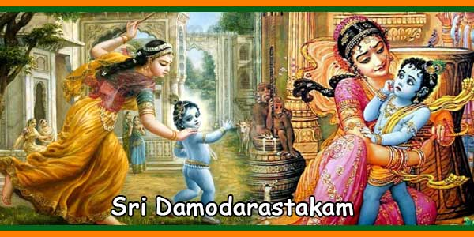

Slide 56
PASURAM 1
Namam isvaram sat- chid ananda rupam
lasat-kuṇḍalam gokule bhrā jamanam
yaśodā-bhi yo lūkha lāddhāva mānam
parā mṛṣṭam atyantato drutya gopyā || 1 ||
நமாமீஶ்வரம் ஸச் சிதாநந்த ரூபம்
லஸத் குண்டலம் கோகுலே ப்ரா ஜமநம் ।
யஶோதாபி யோ லூக லாத்தாவ மாநம்
பரா ம்ருஷ்டம அத்யந்த தோ த்ருத்ய கோப்யா ॥ 1 ॥
नमामीश्वरं सच्-चिद्-आनन्द-रूपं
लसत्कुण्डलं गोकुले भ्राजमनम्
यशोदा-भियोलूखलाद् धावमानं
परामृष्टम् अत्यन्ततो द्रुत्य गोप्या ॥ १॥

Slide 57
Word | meaning
नमामीश्वरं | I bow to god
सच्-चिद्-आनन्द | True bliss
रूपं | form
लसत्कुण्डलं | Shiny earrings
भ्राजमनम् | resplendent
यशोदा-भियो | Fear from yashoda
लूखलाद् | mortar
धावमानं | running
परामृष्टम् | Seized or caught
अत्यन्ततो | Extremely
द्रुत्य | speed
गोप्या | secret

Slide 58
PASURAM 1: Meaning
To the supreme controller, who possesses an eternal form of blissful knowledge, whose glistening earrings swing to and fro, who manifested Himself in Gokula, who stole the butter that the gopis kept hanging from the rafters of their storerooms and who then quickly jumped up and ran in retreat in fear of Mother Yasoda but was ultimately caught – to that Supreme Lord, Sri Damodara, I offer my humble obeisances.

Slide 59
PASURAM 2
rudantam muhur netra-yugmam mṛjantam
karāmbhoja-yugmena sātańka-netram
muhuḥ śvāsa-kampa-trirekhāńka-kaṇṭha-
sthita-graivam dāmodaram bhakti-baddham || 2 ||
ருதந்தம் முஹுர் நேத்ர யுக்மம் ம்ருஜந்தம்
கராம்போஜ யுக்மேந ஸாதங்க நேத்ரம் ।
முஹு꞉ ஶ்வாஸ கம்ப த்ரி ரேகாங்க கண்ட
ஸ்திதக் கரைவம் தாமோதரம் பக்தி பத்தம் ॥ 2 ॥
रुदन्तं मुहुर् नेत्र-युग्मं मृजन्तम्
कराम्भोज-युग्मेन सातङ्क-नेत्रम्
मुहुः श्वास-कम्प-त्रिरेखाङ्क-कण्ठ
स्थित-ग्रैवं दामोदरं भक्ति-बद्धम् ॥ २॥

Slide 60
Word | meaning
रुदन्तं | Act of crying
मुहुर् | Suddenly / in a moment
नेत्र युग्मं | Pair of eyes
मृजन्तम् | wiping
कराम्भोज- | Using his hands
युग्मेन सातङ्क-नेत्रम् | Pair of Lotus shaped eyes
मुहुः | repeatedly
श्वास-कम्प | Trembling breath
त्रिरेखाङ्क-कण्ठ | Tri-linear neck
स्थित-ग्रैवं | Standing / being
दामोदरं | Lord krishna
भक्ति-बद्धम् | Bound by devorion

Slide 61
PASURAM 2: Meaning
Upon seeing His mother’s whipping stick, He cried and rubbed His eyes again and again with His two lotus hands. His eyes were fearful and His breathing quick, and as Mother Yasoda bound His belly with ropes, He shivered in fright and His pearl necklace shook. To this Supreme Lord, Sri Damodara, I offer my humble obeisances.

Slide 62
PASURAM 3
itīdṛk sva-līlābhir ānanda-kuṇḍe
sva-ghoṣam nimajjantam ākhyāpayantam
tadīyeṣit-jñeṣu bhaktair jitatvam
punaḥ prematas tam śatāvṛtti vande || 3 ||
இதீ த்ருக் ஸ்வ லீலாபிர் ஆநந்த குண்டே
ஸ்வ - கோஷம் நிமஜ்ஜந்தம் ஆக்யா பயந்தம் ।
ததீ யேஷித ஜ்ஞேஷு பக்தைர் ஜிதத்வம்
புந꞉ ப்ரேம தஸ் தம் ஶதா வ்ருத்தி வந்தே ॥ 3 ॥
इतीदृक् स्व-लीलाभिर् आनन्द-कुण्डे
स्व-घोषं निमज्जन्तम् आख्यापयन्तम्
तदीयेषित-ज्ञेषु भक्तैर् जितत्वं
पुनः प्रेमतस् तं शतावृत्ति वन्दे ॥ ३॥

Slide 63
Word | meaning
इतीदृक् | Thus,
स्व- | by
लीलाभिर् | His own pastime
आनन्द-कुण्डे | Pool of Pleasure / joy
स्व-घोषं | Self voice
निमज्जन्तम् | immersed
आख्यापयन्तम् | Make known
तदीयेषित- | Belonging to him
ज्ञेषु | knowledge
भक्तैर् | worshipper
जितत्वं | conquered
पुनः | again
प्रेमतस् तं | With love
शतावृत्ति वन्दे | Hundred fold – I praise

Slide 64
PASURAM 3: Meaning
Those superexcellent pastimes of Lord Krishna’s babyhood drowned the inhabitants of Gokula in pools of ecstasy. To the devotees who are attracted only to His majestic aspect of Narayana in Vaikuntha, the Lord herein reveals: “I am conquered and overwhelmed by pure loving devotion.” To the Supreme Lord, Damodara, my obeisances hundreds and hundreds of times.

Slide 65
PASURAM 4
varam deva mokṣam na mokṣāvadhim vā
na canyam vṛṇe ‘ham vareṣād apīha
idam te vapur nātha gopāla-bālam
sadā me manasy āvirāstām kim anyaiḥ || 4 ||
வரம் தேவ மோக்ஷம் ந மோக்ஷா வதிம் வா
ந சாந்யம் வ்ருணே (அ)ஹம் வரேஷாத அபீஹ ।
இதம் தே வபுர்நாத கோபால பாலம்
ஸதா மே மநஸ்யா ஆவிராஸ்தாம் கிம அந்யை꞉ ॥ 4 ॥
वरं देव मोक्षं न मोक्षावधिं वा
न चन्यं वृणे ‘हं वरेषाद् अपीह
इदं ते वपुर् नाथ गोपाल-बालं
सदा मे मनस्य् आविरास्तां किम् अन्यैः ॥ ४॥

Slide 66
Word | meaning
वरं | boon
देव | god
मोक्षं | liberation
न मोक्षावधिं वा | Or the period of salvation
न चन्यं वृणे ‘हं | Not a choice, I ask, Yes,
वरेषाद् | Presiding over boons
अपीह | remove
इदं ते वपुर् नाथ | This is; they
गोपाल-बालं | Cowherd
सदा | forever
मे मनस्य् | In my mind
आविरास्तां किम् अन्यैः | What about the others who appeared

Slide 67
PASURAM 4: Meaning
O Lord, although You are able to give all kinds of benedictions, I do not pray to You for liberation, nor eternal life in Vaikuntha, nor any other boon. My only prayer is that Your childhood pastimes may constantly appear in my mind. O Lord, I do not even want to know your feature of Paramatma. I simply wish that Your childhood pastimes may ever be enacted in my heart.

Slide 68
PASURAM 5
idam te mukhāmbhojam atyanta-nīlair
vṛtam kuntalaiḥ snigdha-raktaiś ca gopyā
muhuś cumbitam bimba-raktādharam me
manasy āvirāstām alam lakṣa-lābhaiḥ || 5 ||
இதம் தே முகாம் போஜம அத்யந்த நீலைர்-
வ்ருதம் குந்தலை꞉ ஸ்நிக்த -ரக்தைஶ்ச கோப்யா ।
முஹுஶ் சும்பிதம் பிம்ப ரக்த தரம் மே
மநஸ்யா விராஸ்தாம் அலம் லக்ஷலாபை꞉ ॥ 5 ॥
इदं ते मुखाम्भोजम् अत्यन्त-नीलैर्
वृतं कुन्तलैः स्निग्ध-रक्तैश् च गोप्या
मुहुश् चुम्बितं बिम्ब-रक्ताधरं मे
मनस्य् आविरास्ताम् अलं लक्ष-लाभैः ॥ ५॥

Slide 69
Word | meaning
इदं ते | This is,
मुखाम्भोजम् | Lotus face
अत्यन्त-नीलैर् | Extremely blue
वृतं | circled
कुन्तलैः स्निग्ध- | Smooth with curls
रक्तैश् च गोप्या | Reddened by the mata yashoda
मुहुश् चुम्बितं | Loving kisses
बिम्ब-रक्ताधरं मे | Reflected in his red skin
मनस्य् आविरास्ताम् | Let them appear In my mind
अलं | Equal to
लक्ष-लाभैः | One lakh benefits

Slide 70
PASURAM 5: Meaning
O Lord, the cheeks of Your blackish lotus face, which is encircled by locks of curling hair, have become reddened like Bimba fruits due to Mother Yasoda’s kisses. What more can I describe than this? Millions of opulences are of no use to me, but may this vision constantly remain in my mind.

Slide 71
PASURAM 6
namo deva dāmodarānanta viṣṇo
prasīda prabho duḥkha-jālābdhi-magnam
kṛpā-dṛṣṭi-vṛṣṭyāti-dīnam batānu
gṛhāṇeṣa mām ajñam edhy akṣi-dṛśyaḥ || 6 ||
நமோ தேவ தாமோதர ஆநந்த விஷ்ணோ
ப்ரஸீத ப்ரபோ து꞉க ஜாலாப்தி மக்நம் ।
க்ருபா த்ருஷ்டி வ்ருஷ்ட்யாதி தீநம் பதாநு
க்ருஹாணேஶ மாம் அஜ்ஞம் எத்யக்ஷி த்ருஶ்ய꞉ ॥ 6 ॥
नमो देव दामोदरानन्त विष्णो
प्रसीद प्रभो दुःख-जालाब्धि-मग्नम्
कृपा-दृष्टि-वृष्ट्याति-दीनं बतानु
गृहाणेष माम् अज्ञम् एध्य् अक्षि-दृश्यः ॥ ६॥

Slide 72
Word | meaning
नमो देव दामोदरानन्त | O lord Damodara,
आनन्त | infinite
विष्णो | vishnu
प्रसीद | Be pleased
प्रभो | Lord
दुःख-जालाब्धि-मग्नम् | Drowned in the ocean of suffering
कृपा-दृष्टि-वृष्ट्याति | Showering your glance and rain of mercy
-दीनं बतानु | This poor,
गृहाणेष | Take this
माम् अज्ञम् | My ignorance
एध्य् अक्षि-दृश्यः | Become visible to my eyes; the vision

Slide 73
PASURAM 6: Meaning
O unlimited Vishnu! O, master! O Lord! Be pleased upon me! I am drowning in an ocean of sorrow and am almost like a dead man. Please shower the rain of mercy on me; uplift me and protect me with Your nectarean vision.

Slide 74
PASURAM 7
kuverātmajau baddha-mūrtyaiva yadvat
tvayā mocitau bhakti-bhājau kṛtau ca
tathā prema-bhaktim svakām me prayaccha
na mokṣe graho me ‘sti dāmodareha || 7 ||
குவேராத் மஜௌ பத்த மூர்த்யைவ யத்வத்
த்வயா மோசிதௌ பக்தி பாஜௌ க்ருதௌ ச ।
ததா ப்ரேம பக்திம் ஸ்வகம் மே ப்ரயச்ச
ந மோக்ஷே க்ரஹோ மே(அ)ஸ்தி தாமோத ரேஹ ॥ 7 ॥
कुवेरात्मजौ बद्ध-मूर्त्यैव यद्वत्
त्वया मोचितौ भक्ति-भाजौ कृतौ च
तथा प्रेम-भक्तिं स्वकां मे प्रयच्छ
न मोक्षे ग्रहो मे ‘स्ति दामोदरेह ॥ ७॥

Slide 75
Word | meaning
कुवेरात्मजौ | The sons of kuvera - nalakuvera and manigriva
बद्ध-मूर्त्यैव यद्वत् | Bound as in the idol itself
त्वया मोचितौ | By you; released
भक्ति-भाजौ | Cultivate devotion
कृतौ च | And in the deeds
तथा प्रेम-भक्तिं | And in the same way, love and devotion
स्वकां मे प्रयच्छ | Give it away your own
न मोक्षे | No desire for liberation
ग्रहो मे | In the planets
‘स्ति | There is
दामोदरेह | Lord krishna

Slide 76
PASURAM 7: Meaning
O Lord Damodara, in Your form as a baby Mother Yasoda, bound You to a grinding stone with a rope for tying cows. You then freed the sons of Kuvera, Manigriva and Nalakuvara, who were cursed to stand as trees and You gave them the chance to become Your devotees. Please bless me in this same way. I have no desire for liberation into Your effulgence.

Slide 77
PASURAM 8
namasthesthu dāmne sphurad-dīpti-dhāmne
tvadīyodarāyātha viśvasya dhāmne
namo rādhikāyai tvadīya-priyāyai
namo ‘nanta-līlāya devāya tubhyam || 8 ||
நமஸ்தே(அ)ஸ்து தாம்நே ஸ்புரத் தீப்தி தாம்நே
த்வதீ யோ தராயாத விஶ்வஸ்ய தாம்நே ।
நமோ ராதிகாயை த்வதீய ப்ரியாயை
நமோ (அ)நந்த லீலாய தேவாய துப்யம் ॥ 8 ॥
नमस् ते ‘स्तु दाम्ने स्फुरद्-दीप्ति-धाम्ने
त्वदीयोदरायाथ विश्वस्य धाम्ने
नमो राधिकायै त्वदीय-प्रियायै
नमो ‘नन्त-लीलाय देवाय तुभ्यम् ॥ ८॥

Slide 78
Word | meaning
नमस् ते ‘स्तु | I bow to you,
दाम्ने | rope
स्फुरद्-दीप्ति | Sparkling brightness
त्वदीयोदरायाथ | To your belly
विश्वस्य धाम्ने | In the abode of the universe
नमो राधिकायै | I bow to you, O radhika
त्वदीय-प्रियायै | Your beloved
नमो ‘ | Obesience to you
नन्त-लीलाय | Infinite pastimes
देवाय तुभ्यम् | To the god, to you

Slide 79
PASURAM 8: Meaning
O Lord, the entire universe was created by Lord Brahma, who was born from Your abdomen, which was bound with a rope by Mother Yasoda. To this rope I offer my humble obeisances. I offer my obeisances to Your most beloved Srimati Radharani and to Your unlimited pastimes

Slide 80



Slide 81
Madhuram madhuram akhilam maduram
madhur-adipater akhilam madhuram || (2) |

Slide 82
PASURAM -1
அத⁴ரம் மது⁴ரம் வத³னம் மது⁴ரம்
நயனம் மது⁴ரம் ஹஸிதம் மது⁴ரம் |
ஹ்ருத³யம் மது⁴ரம் க³மனம் மது⁴ரம்
மது⁴ராதி⁴பதேரகி²லம் மது⁴ரம் || 1 ||
adharam madhuram vadanam madhuram
nayanam madhuram hasitam madhuram
hridayam madhuram gamanam madhuram
madhur-adipater akhilam madhuram || 1 |
अधरं मधुरं वदनं मधुरं नयनं मधुरं हसितं मधुरं ।
हृदयं मधुरं गमनं मधुरं मधुराधिपते रखिलं मधुरं ॥१॥

Slide 83
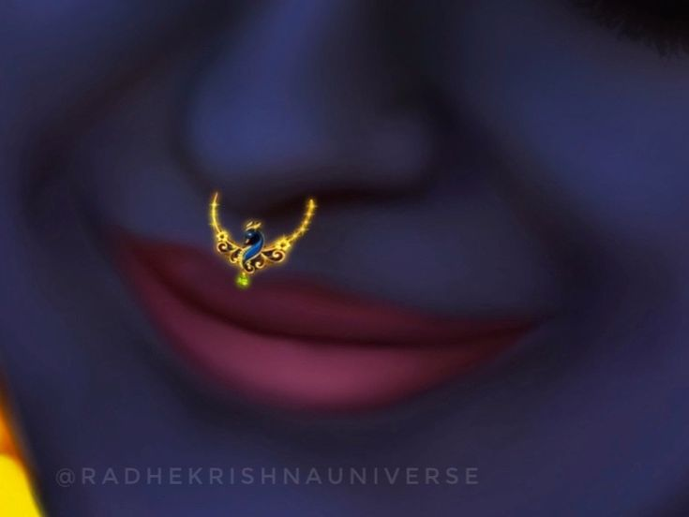
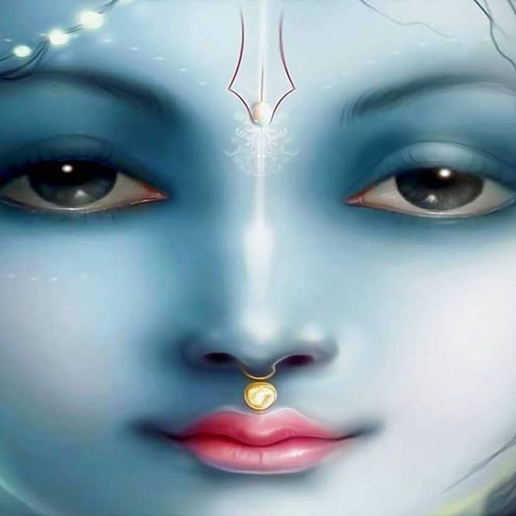
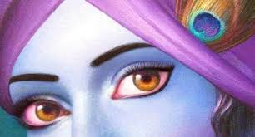
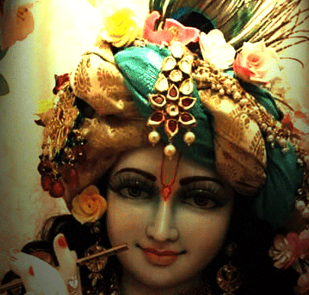
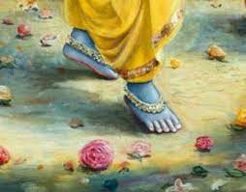
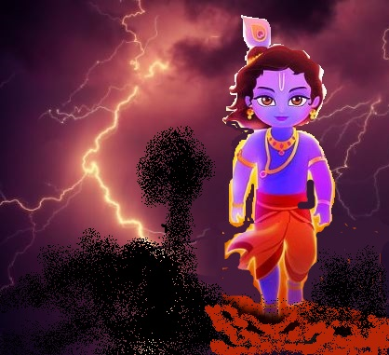
His lips are sweet, His face is sweet, His eyes are sweet, His smile is sweet, His loving heart is sweet, His gait (walk) is sweet, Everything is completely sweet about the Lord of Sweetness

Slide 84
PASURAM -2
வசனம் மது⁴ரம் சரிதம் மது⁴ரம்
வஸனம் மது⁴ரம் வலிதம் மது⁴ரம் |
சலிதம் மது⁴ரம் ப்⁴ரமிதம் மது⁴ரம்
மது⁴ராதி⁴பதேரகி²லம் மது⁴ரம் || 2 ||
vachanam madhuram charitam madhuram
vasanam madhuram valitam madhuram
chalitam madhuram bhramitam madhuram
madhur-adipater akhilam madhuram || 2 ||
वचनं मधुरं चरितं मधुरं वसनं मधुरं वलितं मधुरं ।
चलितं मधुरं भ्रमितं मधुरं मधुराधिपते रखिलं मधुरं ॥२॥

Slide 85
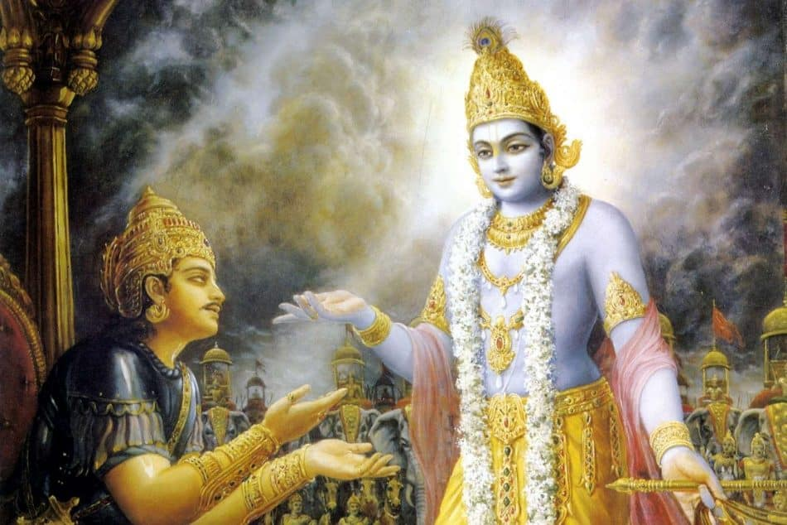
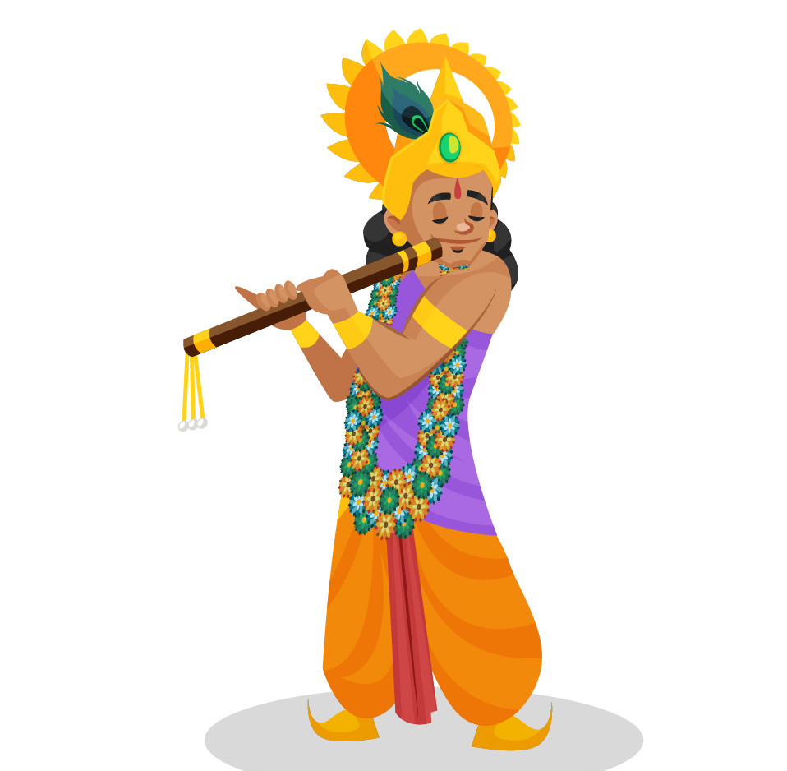
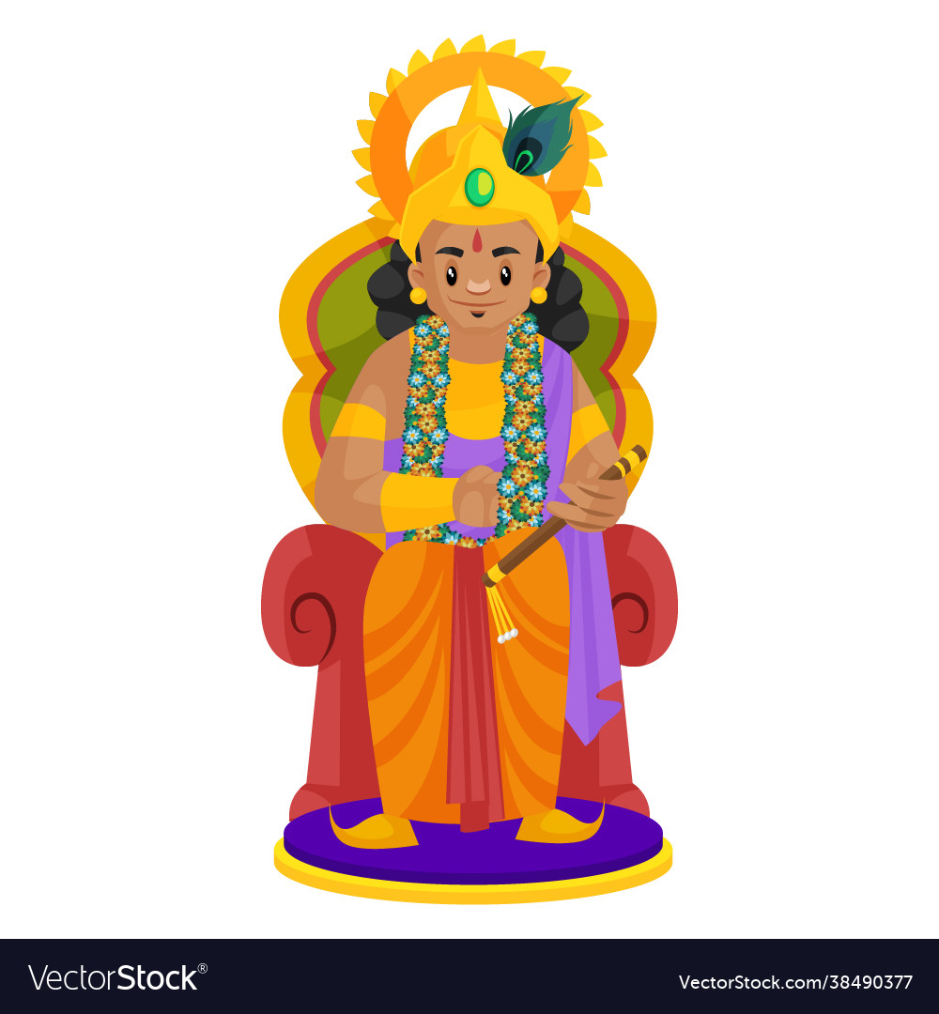
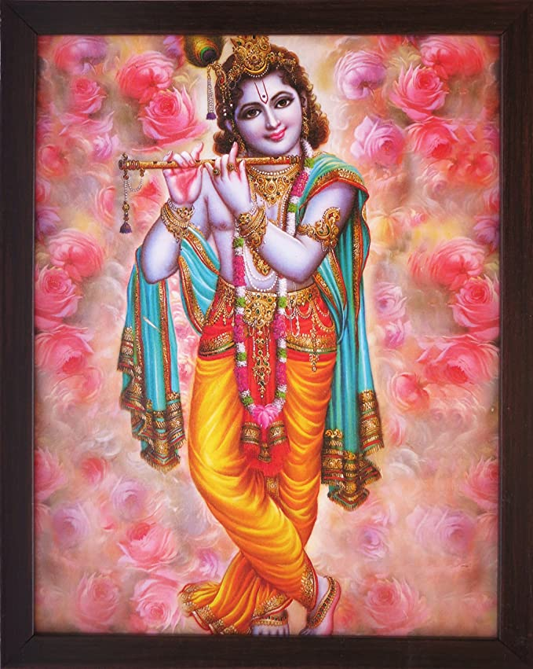
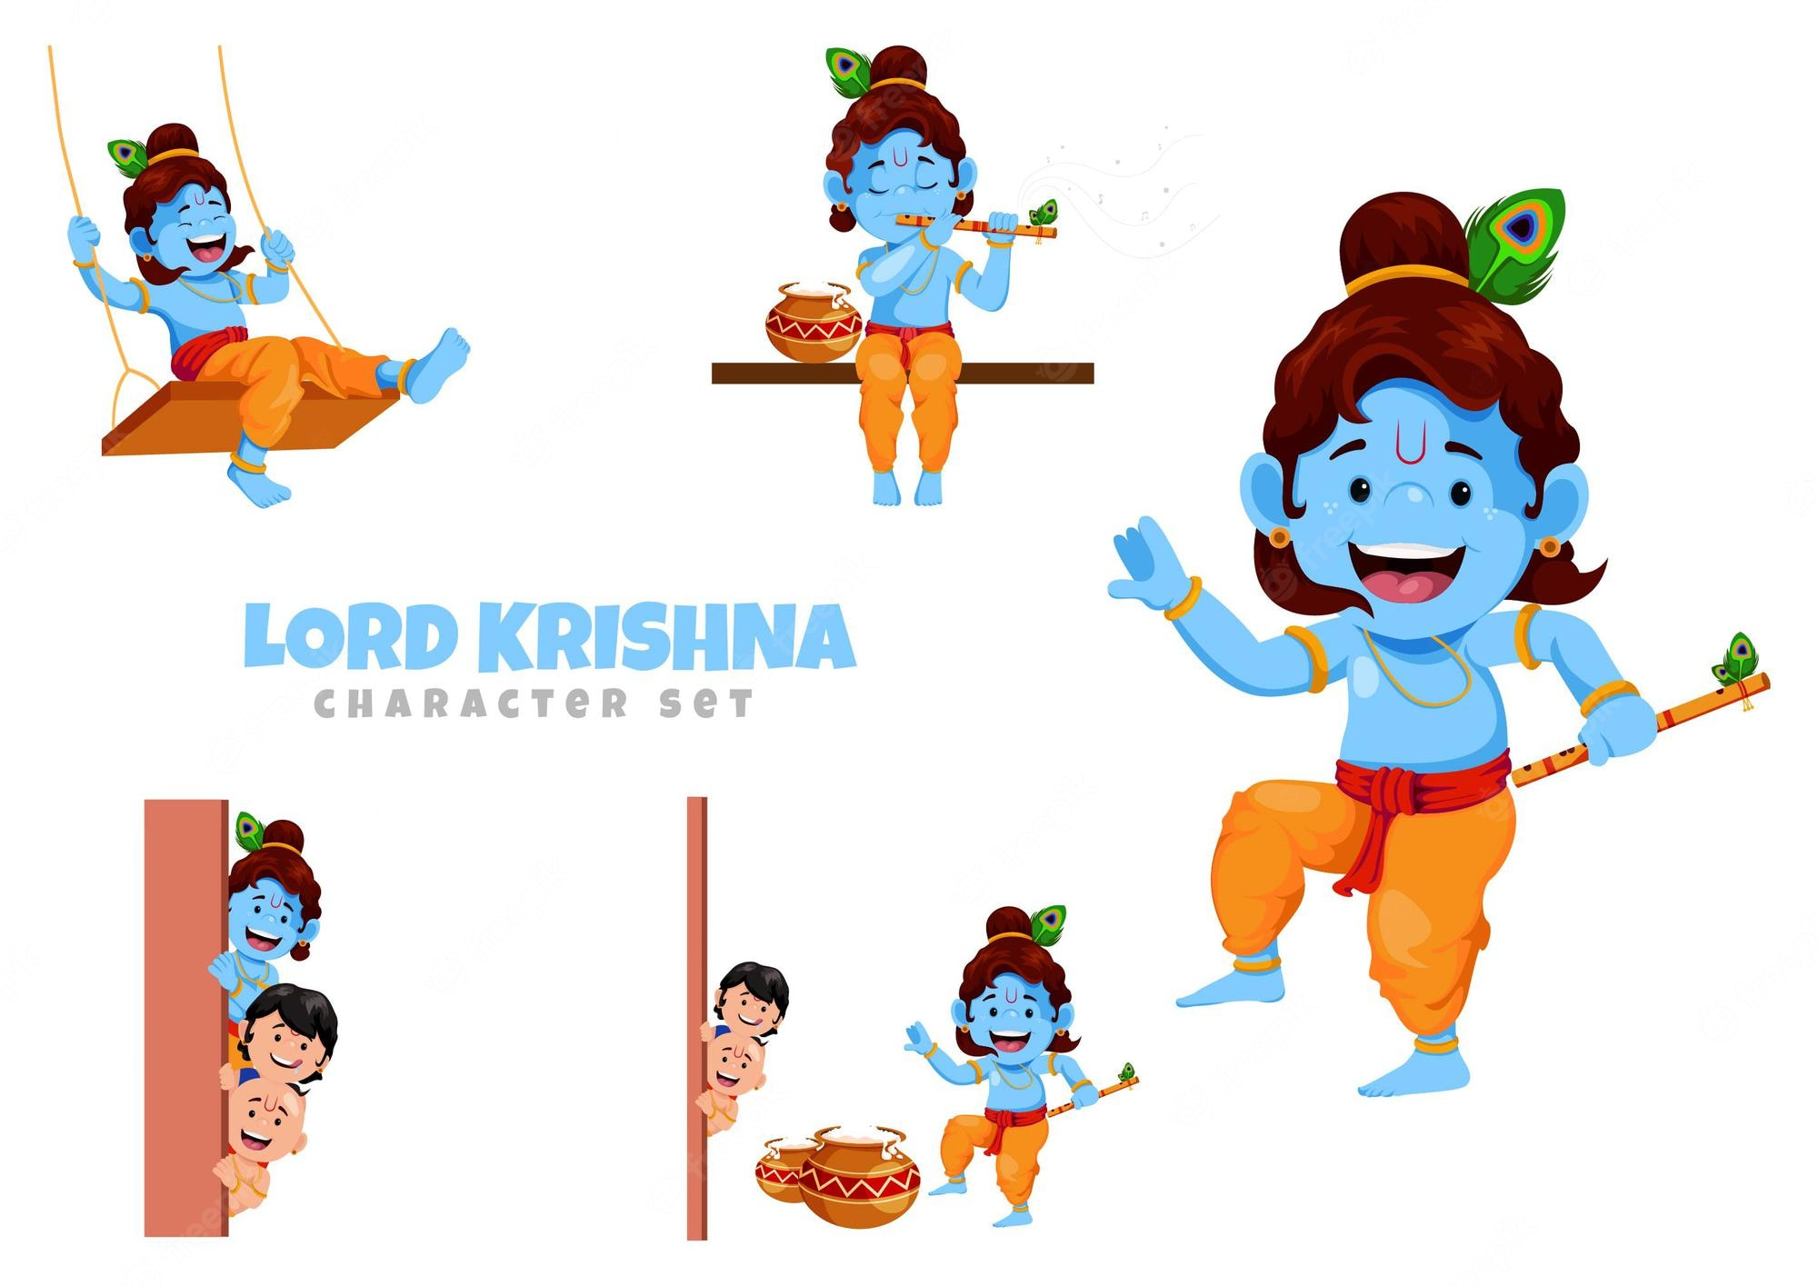
His words are sweet, His character is sweet, His dress (garment) is sweet, His posture is sweet, His movements are sweet, His wandering (roaming) is sweet, Everything is completely sweet about the Lord of Sweetness.

Slide 86
PASURAM -3
வேணுர்மது⁴ரோ ரேணுர்மது⁴ர꞉
பாணிர்மது⁴ர꞉ பாதௌ³ மது⁴ரௌ |
ந்ருத்யம் மது⁴ரம் ஸக்²யம் மது⁴ரம்
மது⁴ராதி⁴பதேரகி²லம் மது⁴ரம் || 3 ||
venur madhuro renur madhurah
panir madhurah padau madhurau
nrityam madhuram shakhyam madhuram
madhur-adipater akhilam madhuram || 3 ||
वेणुर्मधुरो रेणुर्मधुरः पाणिर्मधुरः पादौ मधुरौ ।
नृत्यं मधुरं सख्यं मधुरं मधुराधिपते रखिलं मधुरं ॥३॥

Slide 87
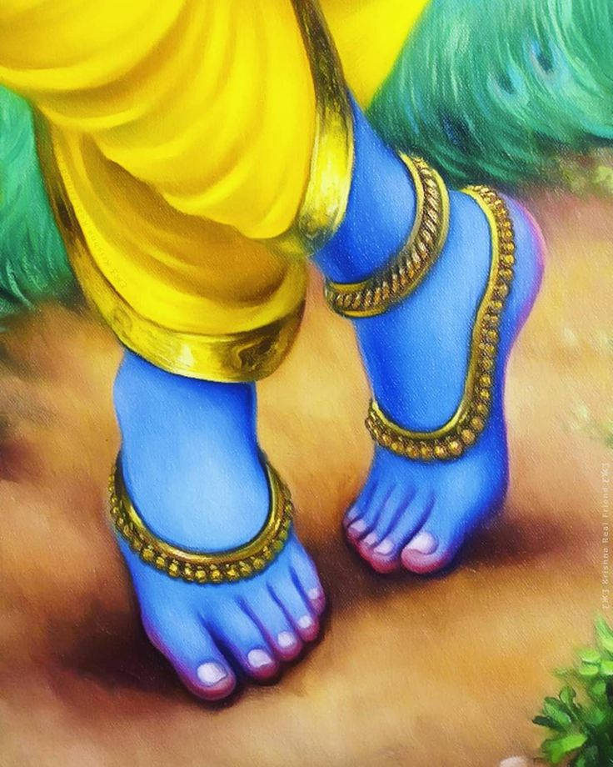
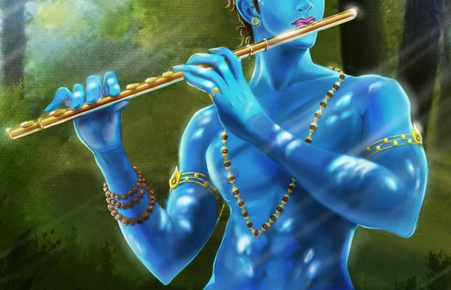
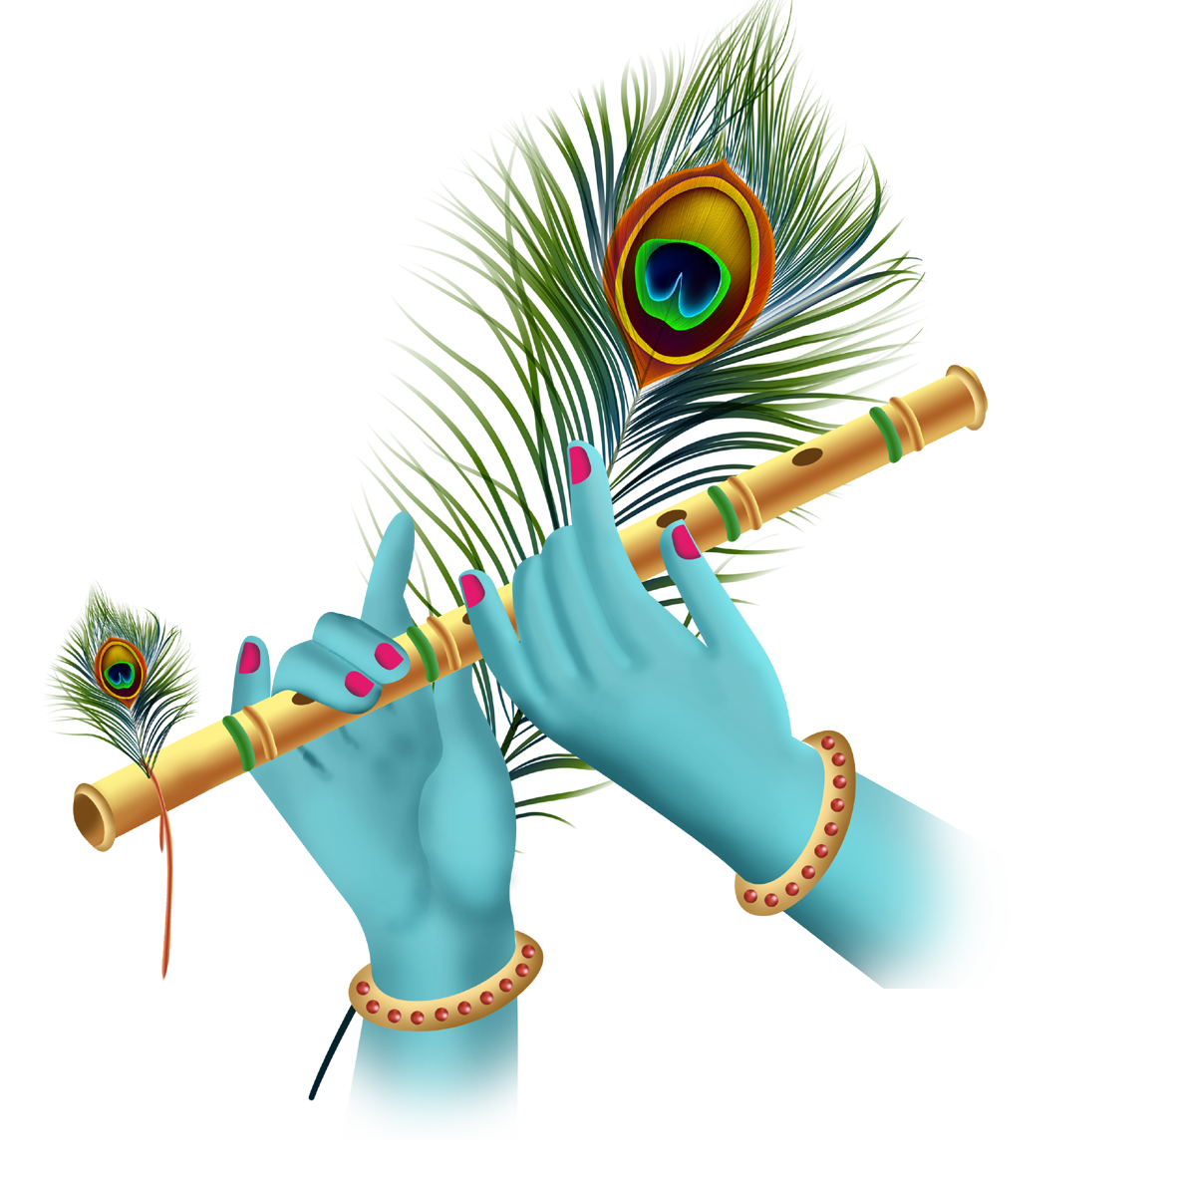
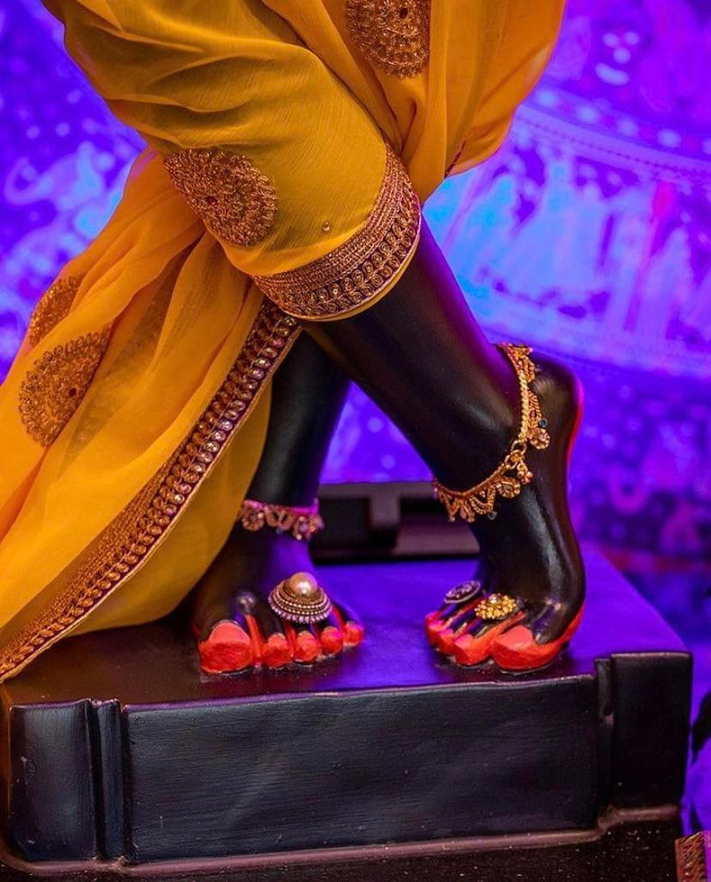
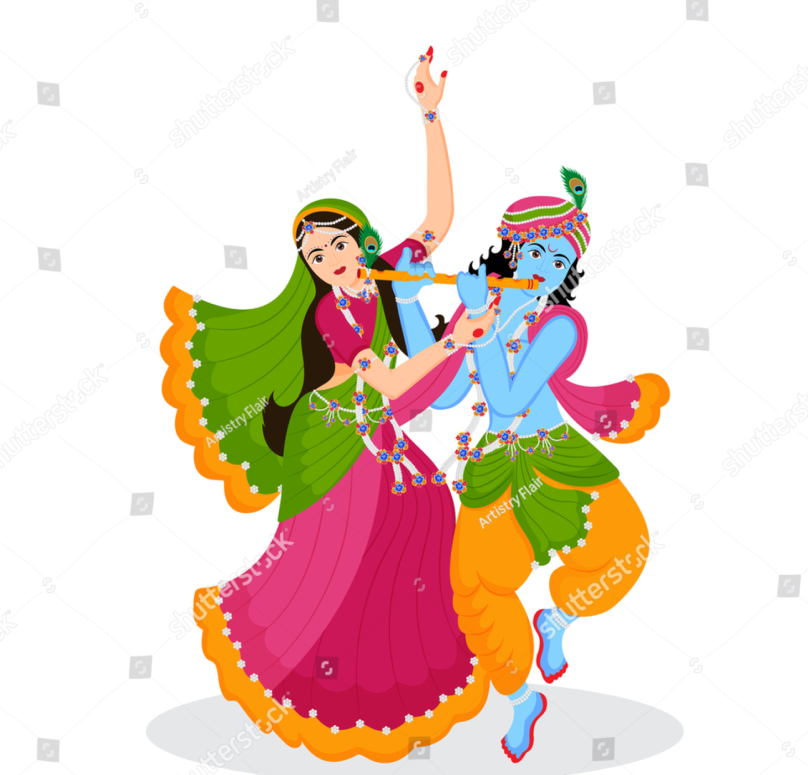
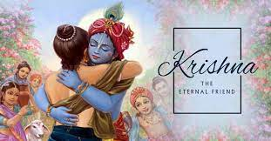
His flute-playing is sweet, His foot-dust is sweet, His hands are sweet, His feet are sweet, His dancing is sweet, His friendship is sweet, Everything is completely sweet about the Lord of Sweetness.

Slide 88
PASURAM -4
கீ³தம் மது⁴ரம் பீதம் மது⁴ரம்
பு⁴க்தம் மது⁴ரம் ஸுப்தம் மது⁴ரம் |
ரூபம் மது⁴ரம் திலகம் மது⁴ரம்
மது⁴ராதி⁴பதேரகி²லம் மது⁴ரம் || 4 ||
gitam madhuram pitam madhuram
bhuktam madhuram suptam madhuram
rupam madhuram tilakam madhuram
madhur-adipater akhilam madhuram || 4 ||
गीतं मधुरं पीतं मधुरं भुक्तं मधुरं सुप्तं मधुरं ।
रूपं मधुरं तिलकं मधुरं मधुराधिपते रखिलं मधुरं ॥४॥

Slide 89
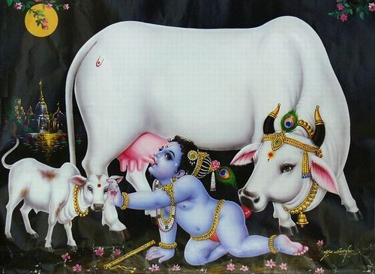
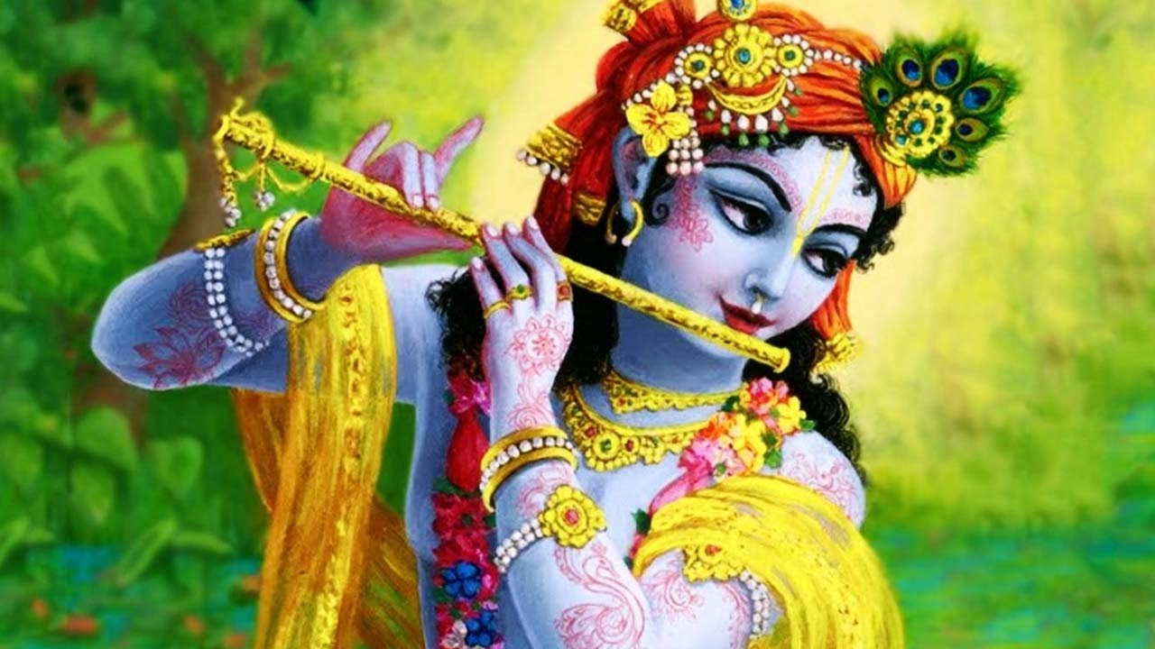
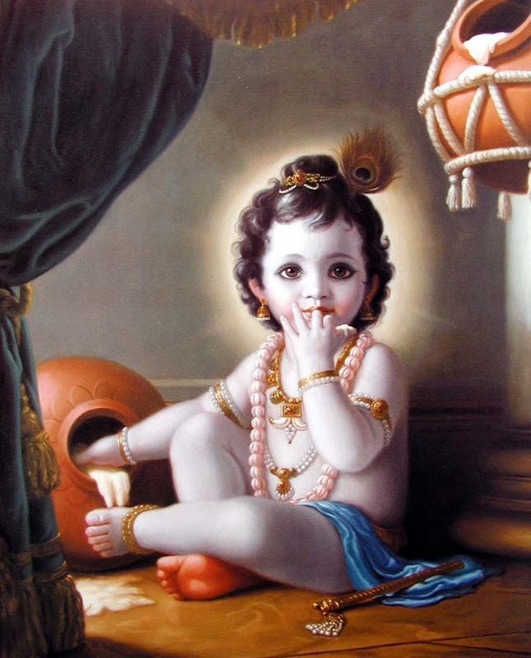
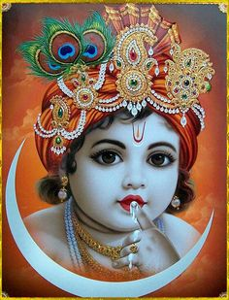
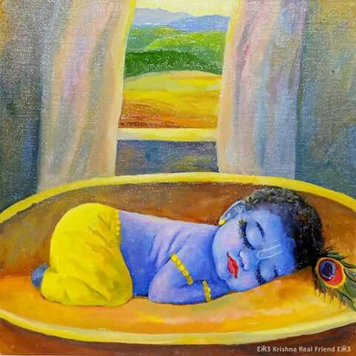
His song is sweet, His drinking is sweet, His eating is sweet, His sleeping is sweet, His beautiful form is sweet, His Tilaka (mark on the forehead) is sweet, Everything is completely sweet about the Lord of Sweetness.

Slide 90
PASURAM -5
கரணம் மது⁴ரம் தரணம் மது⁴ரம்
ஹரணம் மது⁴ரம் ஸ்மரணம் மது⁴ரம் |
வமிதம் மது⁴ரம் ஶமிதம் மது⁴ரம்
மது⁴ராதி⁴பதேரகி²லம் மது⁴ரம் || 5 ||
karanam madhuram taranam madhuram
haranam madhuram ramanam madhuram
vamitam madhuram shamitam madhuram
madhur-adipater akhilam madhuram || 5 ||
करणं मधुरं तरणं मधुरं हरणं मधुरं रमणं मधुरं ।
वमितं मधुरं शमितं मधुरं मधुराधिपते रखिलं मधुरं ॥५॥

Slide 91
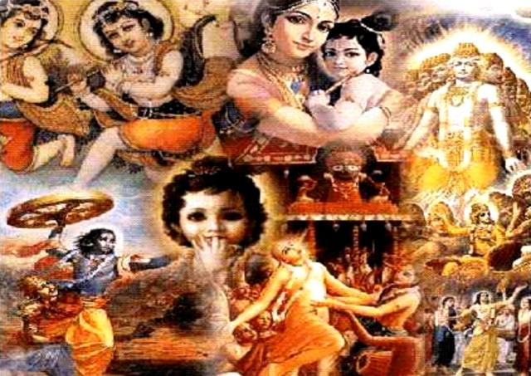
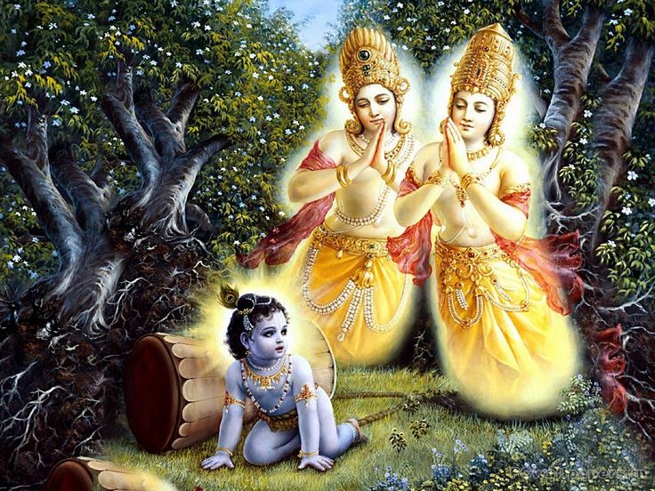
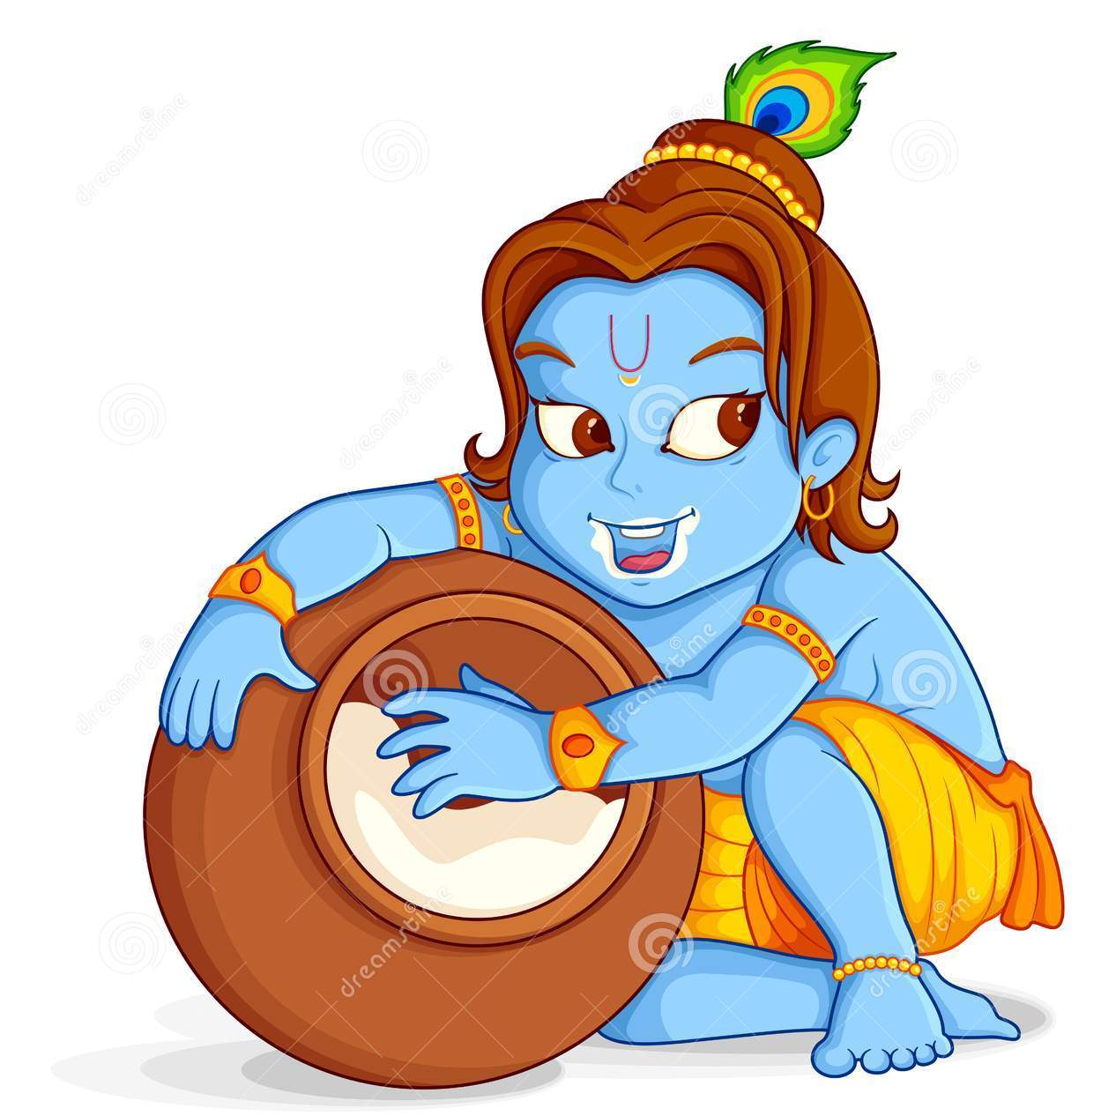
His deeds (activities) are sweet, His conquest (liberating) is sweet, His thieving (stealing) is sweet, His love-sports are sweet, His oblations (offerings) are sweet, His countenance is sweet, Everything is completely sweet about the Lord of Sweetness.

Slide 92
PASURAM -6
கு³ஞ்ஜா மது⁴ரா மாலா மது⁴ரா
யமுனா மது⁴ரா வீசீ மது⁴ரா |
ஸலிலம் மது⁴ரம் கமலம் மது⁴ரம்
மது⁴ராதி⁴பதேரகி²லம் மது⁴ரம் || 6 ||
gunja madhura mala madhura
yamuna madhura vici madhura
salilam madhuram kamalam madhuram
madhur-adipater akhilam madhuram || 6 ||
गुञ्जा मधुरा माला मधुरा यमुना मधुरा वीची मधुरा ।
सलिलं मधुरं कमलं मधुरं मधुराधिपते रखिलं मधुरं ॥६॥

Slide 93
PASURAM -7
கோ³பீ மது⁴ரா லீலா மது⁴ரா
யுக்தம் மது⁴ரம் முக்தம் மது⁴ரம் |
த்³ருஷ்டம் மது⁴ரம் ஶிஷ்டம் மது⁴ரம்
மது⁴ராதி⁴பதேரகி²லம் மது⁴ரம் || 7 ||
gopi madhura lila madhura
yuktam madhuram muktam madhuram
dhristam madhuram shistam madhuram
madhur-adipater akhilam madhuram || 7 ||
गोपी मधुरा लीला मधुरा युक्तं मधुरं मुक्तं मधुरं।
दृष्टं मधुरं सृष्टं मधुरं मधुराधिपते रखिलं मधुरं ॥७॥

Slide 94
PASURAM -8
கோ³பா மது⁴ரா கா³வோ மது⁴ரா
யஷ்டிர்மது⁴ரா ஸ்ருஷ்டிர்மது⁴ரா |
த³லிதம் மது⁴ரம் ப²லிதம் மது⁴ரம்
மது⁴ராதி⁴பதேரகி²லம் மது⁴ரம் || 8 ||
gopa madhura gavo madhura
yastir madhura shristhir madhura
dalitam madhuram phalitam madhuram
madhur-adipater akhilam madhuram || 8 ||
गोपा मधुरा गावो मधुरा यष्टिर्मधुरा सृष्टिर्मधुरा ।
दलितं मधुरं फलितं मधुरं मधुराधिपते रखिलं मधुरं ॥८॥

Slide 95
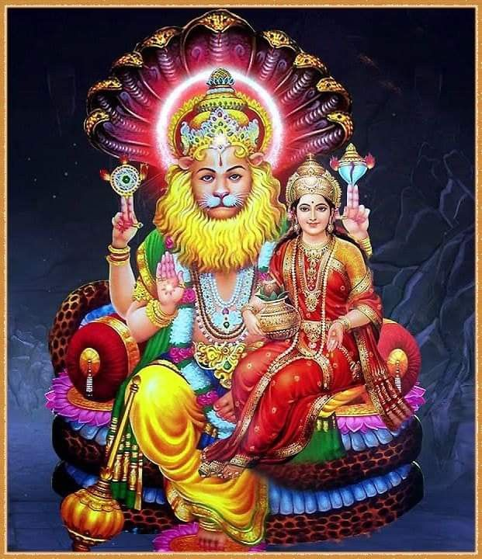
Shri Narasimha Ashtakam
श्री नृसिंहाष्टकम्

Slide 96
Sri Narasimha Maha Mantra
Ugram viram maha-vishnum jvalantam sarvato mukham |
nrisimham bhishanam bhadram mrityur mrityum namamy aham ||
              उग्रं वीरं महाविष्णुं ज्वलन्तं सर्वतोमुखम्।
              नृसिंहं भीषणं भद्रं मृत्युमृत्युं नमाम्यहम् ॥
உக்ரம் வீரம் மஹா விஷ்ணும் ஜ்வலந்தம் ஸர்வதோ முகம்
ந்ரிசிம்ஹம் பீஷணம் பத்ரம் ம்ருத்யுர் ம்ருத்யும் நமாம்யஹம்..

Slide 97
Meaning : ‘I bow down to Lord Narasimha who is ferocious and heroic like Lord Vishnu. He is burning from every side. He is terrific, auspicious and the death of death personified.’

Slide 98
Sri Narasimha Gayathri
ஓம் ந்ரிசிம்ஹாய வித்மஹே வஜ்ரநகாய தீமஹி தன்னோ ஷிம்ஹ ப்ரசோதயாத்.
Om Nrisimhaye vidmahe vajranakhaya dhimahi tan no simhah Prachodayat .
ॐ नृसिंहाय विद्महे वज्रनखाय धीमहि तन्नोसिंह प्रचोदयात् ।

Slide 99
MEANING
Om! Let us be well aware of Nrisimha, the lightning-nailed. May the Lion promote our thought and actions. Let us meditate on He who is known as the possessor of nails as hard as thunderbolts and sharp teeth. Let us all be enthused by Lord Narasimhadeva.

Slide 100
Narasimha Prapatti
Mata narasimha, pita narasimha
Bratha narasimha, sakha Narasimha
மாதா ந்ருஸிம்ஹ: பிதா ந்ருஸிம்ஹ:
பிராதா ந்ருஸிம்ஹ: ஸகா ந்ருஸிம்ஹ:
माता नृसिंहः पिता नृसिंहः ।
भ्राता नृसिंहः सखा नृसिंहः

Slide 101
Narasimha Prapatti
Vidyaa narasimha, dravinam narasimha
Swami narasimha, sakalam Narasimha
வித்யா ந்ருஸிம்ஹ: திரவிணம் ந்ருஸிம்ஹ:
ஸ்வாமி ந்ருஸிம்ஹ: ஸகலம் ந்ருஸிம்ஹ:
विद्या नृसिंहः द्रविणं नृसिंहः ।
स्वामी नृसिंहः सकलं नृसिंहः ॥

Slide 102
Narasimha Prapatti
Itho narasimha, paratho narasimha
Yatho yatho yahi, tatho Narasimha
இதோ ந்ருஸிம்ஹ: பரதோ ந்ருஸிம்ஹ:
யதோ யதோ யாஹி ததோ ந்ருஸிம்ஹ:
इतो नृसिंहः परतो नृसिंहः ।
यतोयतो याहि ततो नरसिंहः

Slide 103
Narasimha Prapatti
Narasimha devaath paro na kaschit
Tasmaan narasimha sharanam prapadye ||
ந்ருஸிம்ஹ தேவாத் பரோ நகஸ்சித்:
தஸ்மான் ந்ருஸிம்ஹ சரணம் ப்ரபத்யே!
नृसिंहदेवात्परो न कश्चित् ।
तस्मान्नृसिंहं शरणं प्रपद्ये ॥

Slide 104
Meaning: ‘Mother is Narasimha; Father is Narasimha
Brother is Narasimha; Friend is Narasimha
Knowledge is Narasimha; Wealth is Narasimha
My Lord is Narasimha; Everything is Narasimha.
Narasimha is in this world, Narasimha is everywhere (Omnipresent)
Wherever I go, there is Narasimha
Narasimha is the Supreme Lord, there is none other than HIM
So, I humbly seek refuge in you, Shri Narasimha.’

Slide 105
PASURAM - 1
श्रीमदकलङ्क परिपूर्ण! शशिकोटि-
श्रीधर! मनोहर! सटापटल कान्त!
ஶ்ரீமத³கலங்க பரிபூர்ண ஶஶிகோடி-
ஶ்ரீத⁴ர மனோஹர ஸடாபடல கான்த।
Śrīmada kalaṅka paripūrṇa śaśikōṭi-
śrīdhara manōhara saṭāpaṭala kānta।

Slide 106
PASURAM - 1
पालय कृपालय! भवांबुधि- निमग्नं
दैत्यवरकाल! नरसिंह! नरसिंह! ||१||
பாலய க்ருபாலய ப⁴வாம்பு³தி⁴-னிமக்³னம்
தை³த்யவரகால நரஸிம்ஹ நரஸிம்ஹ ॥ 1
pālaya kṛpālaya bhavāmbudhi-nimagnaṃ
daityavarakāla narasiṃha narasiṃha ॥ 1 ॥

Slide 107
MEANING
Oh Narasimha, Oh Narasimha, who is the death to great Asura,
Who is like billions of full moons without any stains,
And who carries Lakshmi, who is pretty and has a flowing mane,
Please protect me from this ocean of birth and death, Oh storehouse of mercy.

Slide 108
PASURAM - 2
पादकमलावनत पातकि- जनानां
पातकदवानल! पतत्रिवर- केतो!
பாத³கமலாவனத பாதகி-ஜனானாம்
பாதகத³வானல பதத்ரிவர-கேதோ।
pādakamalāvanata pātaki-janānāṃ
pātakadavānala patatrivara-kētō।

Slide 109
PASURAM - 2
भावन! परायण! भवार्तिहरया मां
पाहि कृपयैव नरसिंह! नरसिंह! ||२||
பா⁴வன பராயண ப⁴வார்திஹரயா மாம்
பாஹி க்ருபயைவ நரஸிம்ஹ நரஸிம்ஹ ॥
bhāvana parāyaṇa bhavārtiharayā māṃ
pāhi kṛpayaiva narasiṃha narasiṃha ॥

Slide 110
MEANING
Please show me your mercy, Oh Narasimha, Oh Narasimha,
Who is the forest fire that burns all the sins committed by sinners,
If they bow down to your holy lotus flower-like feet,
And who has a Garuda flag on his chariot,who is the cause of creation,
And the best shelter, Please help me remove the problems of birth and death.

Slide 111
PASURAM - 3
तुङ्गनख- पङ्क्ति- दलितासुर- वरासृक्
पङ्क- नवकुङ्कुम- विपङ्किल- महोरः |
துங்க³னக-²பங்க்தி-த³லிதாஸுர-வராஸ்ருக்
பங்க-னவகுங்கும-விபங்கில-மஹோர: ।
tuṅganakha-paṅkti-dalitāsura-varāsṛk
paṅka-navakuṅkuma-vipaṅkila-mahōraḥ ।

Slide 112
PASURAM - 3
पण्डितनिधान- कमलालय नमस्ते
पङ्कजनिषण्ण! नरसिंह! नरसिंह! ||३||
பண்டி³தனிதா⁴ன-கமலாலய நமஸ்தே
பங்கஜ னிஷண்ண நரஸிம்ஹ நரஸிம்ஹ ॥ 3
Paṇḍita nidhāna-kamalālaya namastē
paṅkaja niṣaṇṇa narasiṃha narasiṃha ॥ 3

Slide 113
MEANING
Oh Narasimha, Oh Narasimha, who lives in a lotus,
Your outstretched nails tore open the entrails of the asura,
And the blood out of him fell on your chest, making,
It appears as if Kumkum has been applied to your chest,
My salutations to you who is the residence of learned as well as Lakshmi.

Slide 114
PASURAM - 4
मौलेषु विभूषणमिवामर वराणां
योगिहृदयेषु च शिरस्सु निगमानाम् |
மௌலேஷு விபூ⁴ஷணமிவாமர வராணாம்
யோகி³ஹ்ருத³யேஷு ச ஶிரஸ்ஸுனிக³மானாம் ।
mauleṣu vibhūṣaṇamivāmara varāṇāṃ
yōgihṛdayēṣu cha śirassunigamānām ।

Slide 115
PASURAM - 4
राजदरविन्द- रुचिरं पदयुगं ते
देहि मम मूर्ध्नि नरसिंह! नरसिंह! ||४||
ராஜத³ரவின்த-³ருசிரம் பத³யுக³ம் தே
தே³ஹி மம மூர்த்⁴னி நரஸிம்ஹ நரஸிம்ஹ ॥ 4
rājadaravinda-ruchiraṃ padayugaṃ tē
dēhi mama mūrdhni narasiṃha narasiṃha ॥

Slide 116
MEANING
Oh Narasimha , Oh Narasimha please keep
Your twin lotus-like feet on my head,
Though it is kept on the crowns of the helmets of gods,
And also on the heart of sages and on the Veda books.

Slide 117
PASURAM - 5
वारिजविलोचन! मदन्तिम- दशायां
क्लेश- विवशीकृत- समस्त- करणायाम् |
வாரிஜவிலோசன மத³ன்திம-த³ஶாயாம்
க்லேஶ-விவஶீக்ருத-ஸமஸ்த-கரணாயாம் ।
vārijavilōchana madantima-daśāyāṃ
klēśa-vivaśīkṛta-samasta-karaṇāyām ।

Slide 118
PASURAM - 5
एहि रमया सह शरण्य! विहगानां
नाथमधिरुह्य नरसिंह! नरसिंह! ||५||
ஏஹி ரமயா ஸஹ ஶரண்ய விஹகா³னாம்
நாத²மதி⁴ருஹ்ய நரஸிம்ஹ நரஸிம்ஹ ॥
ēhi ramayā saha śaraṇya vihagānāṃ
nāthamadhiruhya narasiṃha narasiṃha ॥

Slide 119
MEANING
Oh Narasimha, Oh Narasimha, along with Lakshmi,
Come riding on the Garuda, the king of birds,
At a time when all my senses are suffering in distress,
At the time of death, Oh lotus-eyed one,

Slide 120
PASURAM - 6
हाटक- किरीट- वरहार- वनमाला
धाररशना- मकरकुण्डल- मणीन्द्रैः |
ஹாடக-கிரீட-வரஹார-வனமாலா
தா⁴ரரஶனா-மகரகுண்ட³ல-மணீன்த்³ரை: ।
hāṭaka-kirīṭa-varahāra-vanamālā
dhāraraśanā-makarakuṇḍala-maṇīndraiḥ ।

Slide 121
PASURAM - 6
भूषितमशेष- निलयं तव वपुर्मे
चेतसि चकास्तु नरसिंह! नरसिंह! ||६||
பூ⁴ஷிதமஶேஷ-னிலயம் தவ வபுர்மே
சேதஸி சகாஸ்து நரஸிம்ஹ நரஸிம்ஹ ॥
bhūṣitamaśēṣa-nilayaṃ tava vapurmē
chētasi chakāstu narasiṃha narasiṃha ॥

Slide 122
MEANING
Oh Narasimha, Oh Narasimha, Your divine body,
Wearing a pretty blessed crown, forest garland,
And fish like gem studded ear studs shining like stars,
Lives in the unapproachable residence of yours.

Slide 123
PASURAM - 7
इन्दु रवि पावक विलोचन! रमायाः
मन्दिर! महाभुज! – लसद्वर- रथाङ्ग!
இன்து³ ரவி பாவக விலோசன ரமாயா:
மன்தி³ர மஹாபு⁴ஜ-லஸத்³வர-ரதா²ங்க।³
indu ravi pāvaka vilōchana ramāyāḥ
mandira mahābhuja-lasadvara-rathāṅga।

Slide 124
PASURAM - 7
सुन्दर! चिराय रमतां त्वयि मनो मे
नन्दित सुरेश! नरसिंह! नरसिंह! ||७||
ஸுன்த³ர சிராய ரமதாம் த்வயி மனோ மே
நன்தி³த ஸுரேஶ நரஸிம்ஹ நரஸிம்ஹ ॥
sundara chirāya ramatāṃ tvayi manō mē
nandita surēśa narasiṃha narasiṃha ॥

Slide 125
MEANING
Oh Narasimha, Oh Narasimha, who is honoured by Indra,
Let my mind play on your very pretty form,
Which has moon, sun, and fire as eyes,
Which is the temple of Goddess Lakshmi,
And which holds in the great hands the holy wheel.

Slide 126
PASURAM - 8
माधव! मुकुन्द! मधुसूदन! मुरारे!
वामन! नृसिंह! शरणं भव नतानाम् |
மாத⁴வ முகுன்த³ மது⁴ஸூத³ன முராரே
வாமன ந்ருஸிம்ஹ ஶரணம் ப⁴வ நதானாம் ।
mādhava mukunda madhusūdana murārē
vāmana nṛsiṃha śaraṇaṃ bhava natānām ।

Slide 127
PASURAM - 8
कामद घृणिन् निखिलकारण नयेयं
कालममरेश नरसिंह! नरसिंह! ||८||
காமத³ க்⁴ருணின் நிகி²லகாரண நயேயம்
காலமமரேஶ நரஸிம்ஹ நரஸிம்ஹ ॥
kāmada ghṛṇin nikhilakāraṇa nayēyaṃ
kālamamarēśa narasiṃha narasiṃha ॥ 8 ॥

